Slide 1
Using the
Collaboration application on your computer

Slide 2
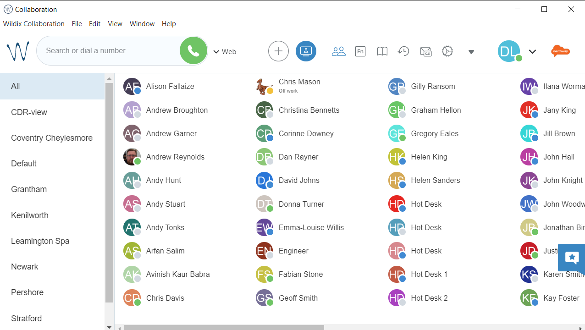
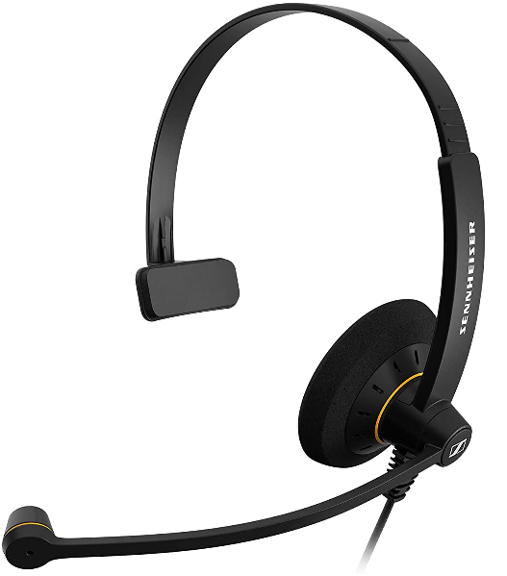
Introduction
Wildix is the new society-wide telephony system. It is being implemented from mid-2021 onwards and will replace all legacy telephony systems.
This training presentation will help you navigate and use the Wildix Collaboration application on your computer. It may be helpful to have Collaboration open while you work through this training pack. If you haven’t accessed Collaboration before, please see “Travel Branches – Accessing the Collaboration desktop app” on Colleagues Connect.
If you have any questions, please contact the project team via unified.communications@midcounties.coop

Slide 3
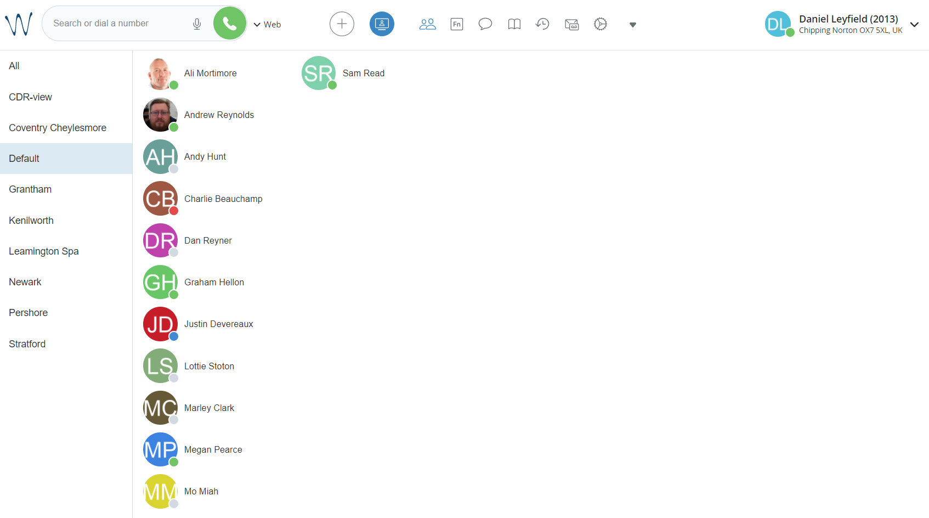
Navigation
Select the device you would like to use to dial, then select the green telephone to call
Enter a number or enter a name to search to dial out
Next

Slide 4
Navigation
Find all your colleagues here
Filter colleagues by selecting a department or branch
Next

Slide 5
Navigation
Access videoconferencing here
Next

Slide 6
Navigation
Function keys created are found here
Next

Slide 7
Navigation
Here are your phonebooks
Next

Slide 8
Navigation
Click here to view your activity history
Next

Slide 9
Navigation
Access voicemails here
Next

Slide 10
Navigation
Click here for settings
Next

Slide 11
Navigation
Less used functions are found here
Next

Slide 12
Navigation
Change your status by clicking here
Next

Slide 13
Navigation
Edit your picture or logout here
Next

Slide 14
Making calls
Select a number to dial from phonebook, colleague screen or direct entry.
A call control pop-up appears.
Mute (flashes when muted)
Put on hold
Record call
Number pad
Click the video to play
Transfer
To Voicemail
Call first
Direct transfer
More options
End call
Next

Slide 15
Receiving calls
A call control pop-up appears when a call is incoming.
Answer call
Decline call
Forward
To Voicemail
(to own VM or other user’s)
Number pad
When answered, more options are available.
Mute (flashes when muted)
Click the video to play
Put on hold
Record call
Transfer
To Voicemail
Call first
Direct transfer
More options
End call
Next

Slide 16
Switch device while on a call
During a call you can switch the device you are using between a handset, Collaboration and mobile app. In this video the call originated on the mobile phone app.
Using Collaboration, select the black triangle to show available devices under Continuity.
There is the option to switch to the web (Collaboration). If there was a handset available, this would also be listed here.
Select the device and the call will be immediately transferred.
You can switch to any device throughout the call.
Click the video to play
Next

Slide 17
Edit visible colleagues
To change which colleagues are visible, select Edit Colleagues from the Other menu.
Scroll through the list and select or deselect those you want to see. You can select a whole department or just individuals.
Select  to save.
Your changes can be seen on the Colleagues screen.
Click the video to play
Next

Slide 18
Edit phonebooks
To add a phone book, select Edit Phonebooks from the drop down menu.
Select +.
Enter a name for the phonebook and select .
Close this window and return to the drop down menu. Select the phonebook you want to add a contact to and select +.
Enter the details and select .
You can call any contact in a phonebook just by typing their name in the dialling area.
Click the video to play
Next

Slide 19
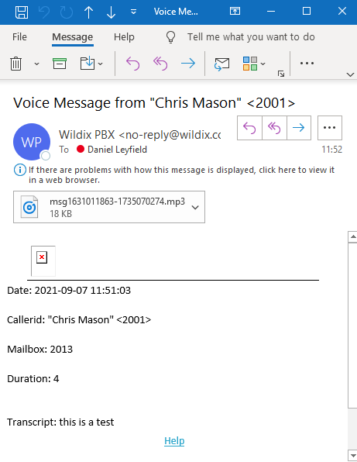
Voicemails
A notification is shown for new voicemails
You will also get an email with the recording attached
Next

Slide 20
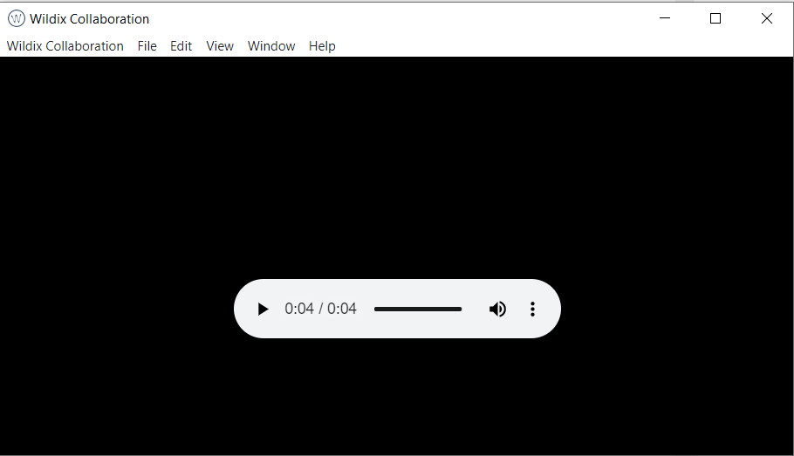
Voicemails
New voicemails are shown in bold
Select this icon to listen to your voicemail
A window pops up for you to listen to your voicemail

