Slide 1
Accessing the
Collaboration application on your computer

Slide 2
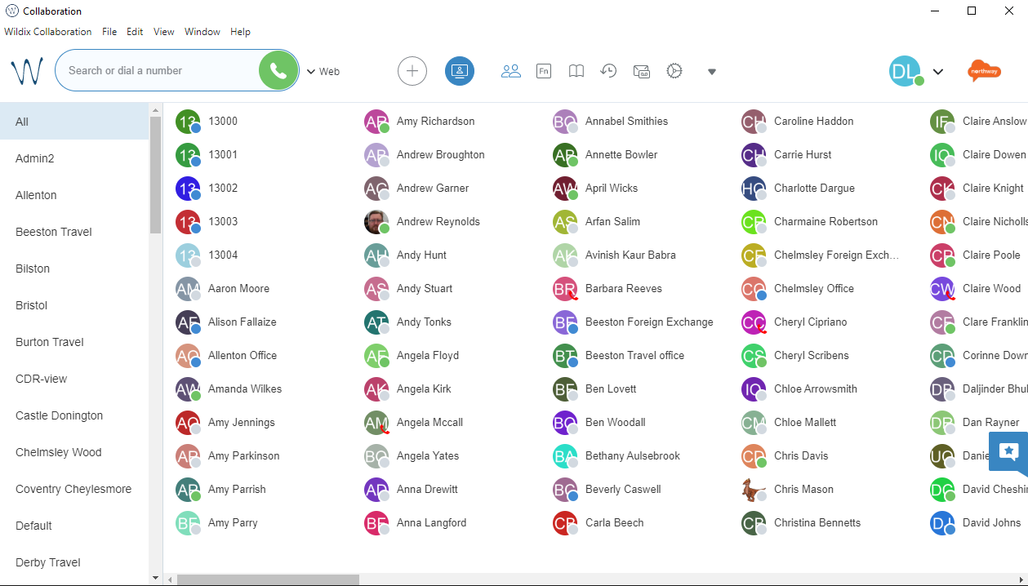
Introduction
Wildix is the new society-wide telephony system. Implementation started mid-2021 and will replace all legacy telephony systems.
This training presentation will help you access the Wildix Collaboration application on your computer.
If you have any general questions, please contact the project team via unified.communications@midcounties.coop.
For specific support issues, please raise via ServiceNow under the category of “Wildix VOIP”.

Slide 3
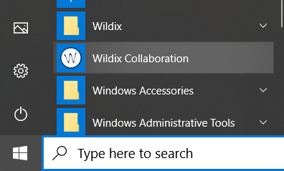
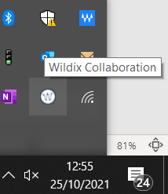
Accessing the Wildix desktop application
Wildix should automatically open every time you log in
If you ever need to open it manually, just type “Wildix” into your search bar or search in your list of applications
Once open, Wildix may minimise to your system tray when not in use. It will still be running in the background
To maximise Wildix, just click on the up arrow near your clock and select the Wildix Collaboration icon

Slide 4
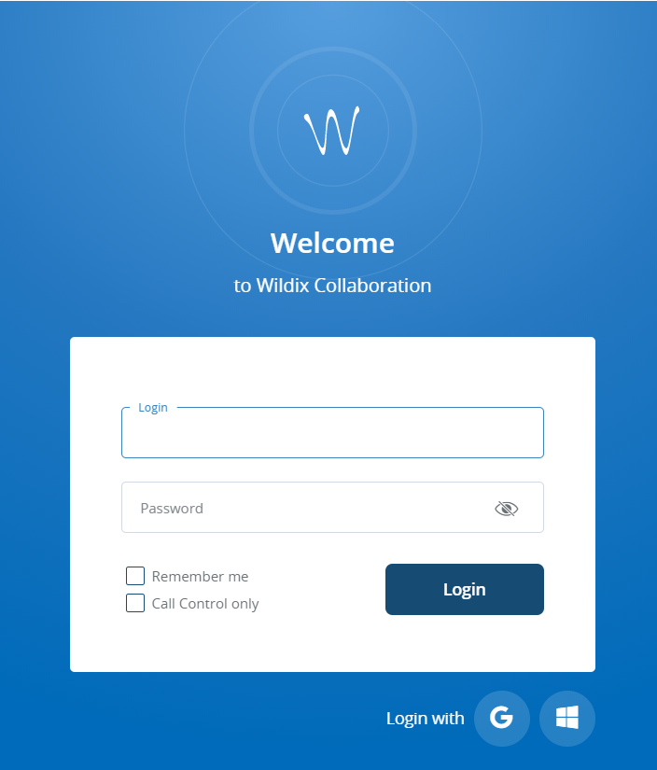
Signing in to Wildix
On the Welcome screen, select the Windows icon at the bottom right of the screen
Sometimes, you may need to sign in and add your password. This may lead to Multi Factor Authentication for security reasons. The next slide details this process. Do not worry if you do not have to go through this process.

Slide 5
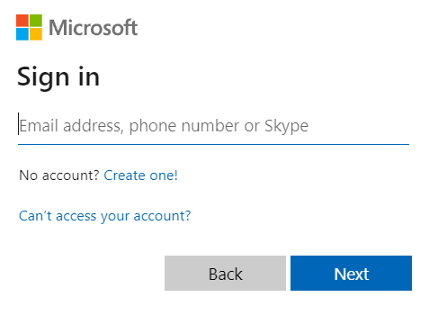
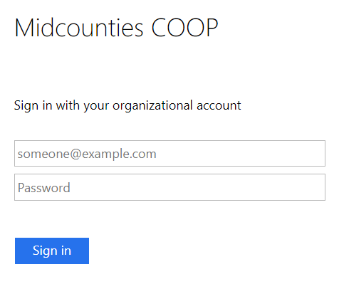
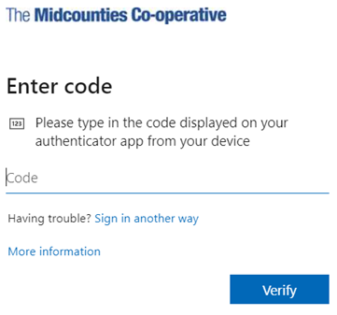
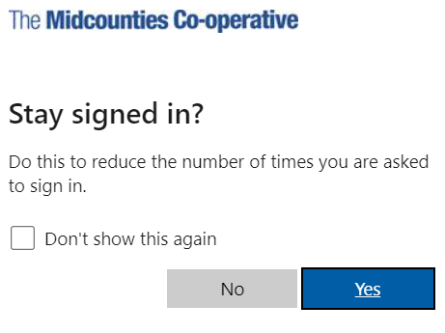
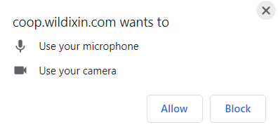
Enter your email
Enter your normal password
You may need to perform Multi Factor Authorisation. Follow the on screen instructions to validate your log in
Select Stay signed in if asked
Allow access to microphone and camera if asked

Slide 6
Welcome to Collaboration
To find out how to use Collaboration, please see “Using the Collaboration desktop app” on Colleagues Connect.

