Slide 1
Using the
Collaboration application on your computer

Slide 2
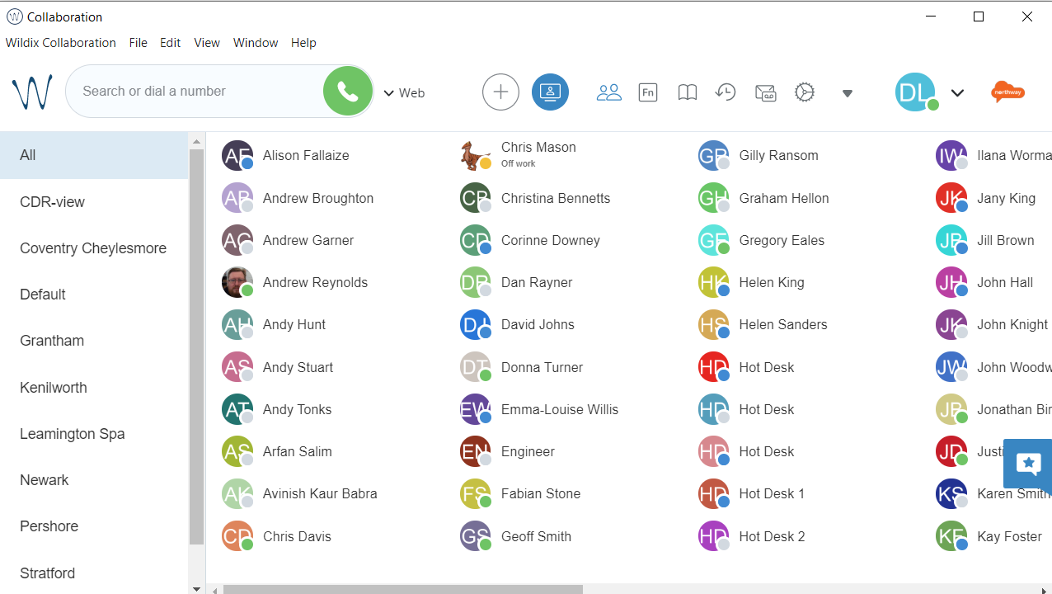
Introduction
Wildix is the new society-wide telephony system. Implementation started mid-2021 and will replace all legacy telephony systems.
This training presentation will help you navigate and use the Wildix Collaboration application on your computer. It may be helpful to have Collaboration open while you work through this training pack. If you haven’t accessed Collaboration before, please see “Accessing the Collaboration desktop app” on Colleagues Connect.
If you have any general questions, please contact the project team via unified.communications@midcounties.coop.
For specific support issues, please raise via ServiceNow under the category of “Wildix VOIP”.
Next

Slide 3
Contents
The next group of slides will show you around the main screens of Wildix. Some functions require additional explanation – these can be found on later slides with videos to help you.
Navigation – How to make a call
Navigation – Colleague display
Navigation – Video conferencing
Navigation – Phonebooks
Navigation – Activity history
Navigation – Voicemails
Navigation – Settings
Navigation – Other functions
Navigation – Status
Navigation – Edit picture/logout
Making calls
Receiving calls
Transferring Calls
Switch device while on a call
Edit visible colleagues
Edit phonebooks
Voicemails
Call forwarding and other settings
Useful functions
Next

Slide 4
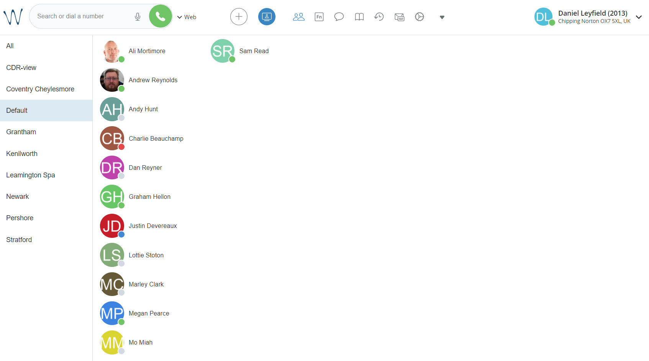
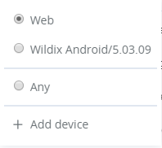
Navigation
Enter a number or enter a name to search to dial out
Select the device you would like to use to dial (“Web” to use your computer); then select the green telephone to call
Next

Slide 5
Navigation
Find the colleagues you have chosen to view here
Filter these colleagues by selecting a department or branch
Next

Slide 6
Navigation
Access video conferencing here
Next

Slide 7
Navigation
Here are your phonebooks
Next

Slide 8
Navigation
Click here to view your activity history
Next

Slide 9
Navigation
Access voicemails here
Next

Slide 10
Navigation
Click here for settings
Next

Slide 11
Navigation
Less used functions are found here
Next

Slide 12
Navigation
Change your status by clicking here
Next

Slide 13
Navigation
Edit your picture or logout here
Next

Slide 14
Making calls
Select a number to dial from phonebook, colleague screen or direct entry.
A call control pop-up appears.
Mute (flashes when muted)
Put on hold
Record call
Number pad
Transfer
To Voicemail
Call first
Direct transfer
Click the video to play
More options
End call
Next

Slide 15
Receiving calls
A call control pop-up appears when a call is incoming.
Answer call
Decline call
Forward
To Voicemail
(to own VM or other user’s)
Number pad
When answered, more options are available.
Mute (flashes when muted)
Put on hold
Click the video to play
Record call
Transfer
To Voicemail
Call first
Direct transfer
More options
End call
Next

Slide 16
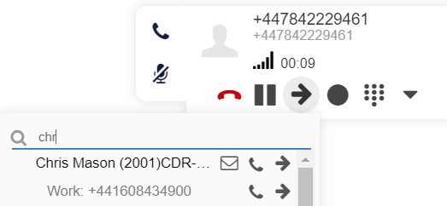
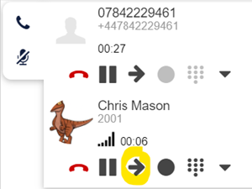
Transferring Calls
While a call is in progress, select the button
Search for the colleague to transfer to by typing their name
You can transfer to their voicemail – select the icon
You can transfer the call without speaking to them first – select the
Or you can speak to the them first – select the
While speaking to the colleague to transfer to, the original caller is placed on hold
You can switch between callers by pressing the hold button for the relevant line
When ready to transfer, just select on the bottom call (circled in yellow on screenshot)

Slide 17
Switch device while on a call
During a call you can switch the device you are using between a handset, Collaboration and mobile app. In this video the call originated on the mobile phone app.
Using Collaboration, select the black triangle to show available devices under Continuity.
There is the option to switch to the web (Collaboration). If there was a handset available, this would also be listed here.
Select the device and the call will be immediately transferred.
You can switch to any device throughout the call.
Click the video to play
Next

Slide 18
Edit visible colleagues
To change which colleagues are visible, select Edit Colleagues from the Other menu.
Scroll through the list and select or deselect those you want to see. You can select a whole department or just individuals.
Select  to save.
Your changes can be seen on the Colleagues screen.
Click the video to play
Next

Slide 19
Edit phonebooks
To add a phone book, select Edit Phonebooks from the drop down menu.
Select +.
Enter a name for the phonebook and select .
Close this window and return to the drop down menu. Select the phonebook you want to add a contact to and select +.
Enter the details and select .
You can call any contact in a phonebook just by typing their name in the dialling area.
Click the video to play
Next

Slide 20
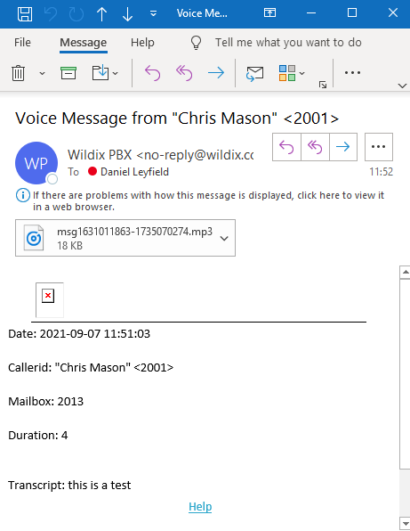
Voicemails
A notification is shown for new voicemails
You will also get an email with the recording attached
To record your own voicemail message and access other voicemail functions, just dial *97 and follow the instructions
Next

Slide 21
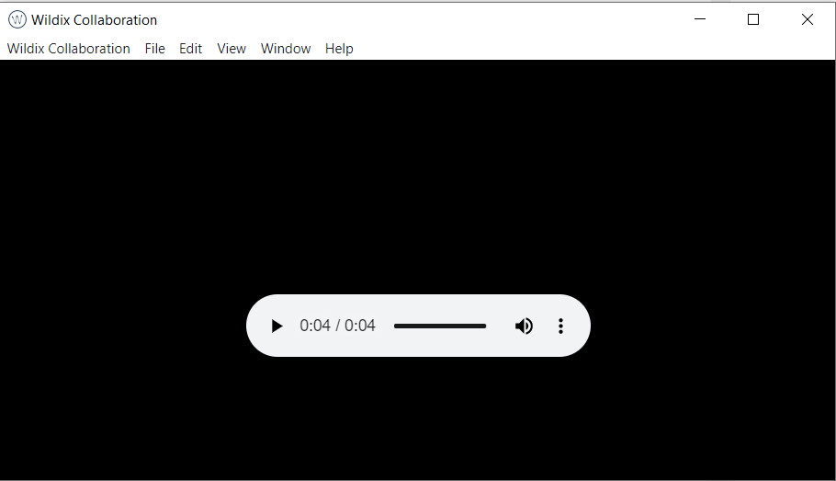
Voicemails
New voicemails are shown in bold
Select this icon to listen to your voicemail
A window pops up for you to listen to your voicemail

Slide 22
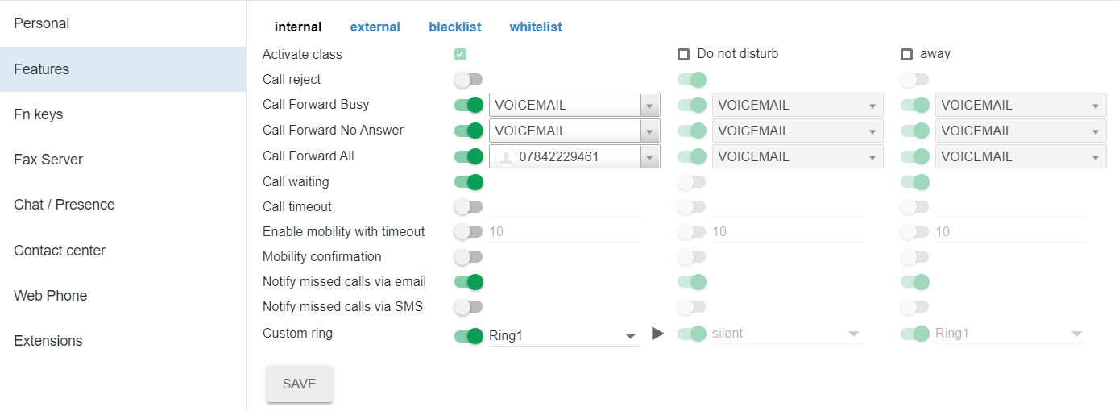
Call forwarding and other settings
To forward calls to a mobile or other external number
Go to Settings then Features
Enter the number to forward to depending on if you want all calls forwarded, just when busy or not answered
When the forward needs activating, enable the selector on the left so that it is green
In the example below, all calls will forward to the mobile number
Deselect when the forward is no longer required
You can set up different behaviours for internal and external calls and also depending on your status – to do this, go into each section and select Activate class. Otherwise whatever you enter in the Internal section, with just the green tick next to Activate class as shown below, will apply for all calls and statuses
To amend the amount of time before a call goes to voicemail, enter the number of seconds next to Call timeout and move the selector to green
Ringtones and missed calls notification behaviour may also be modified here

Slide 23
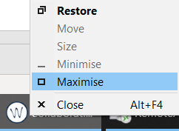
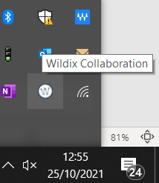
Useful tips
If you make a change or your screen ever goes blank, press Ctrl and R to refresh
If Wildix is open but won’t display, select Shift and right hand mouse button on the toolbar icon, then select Maximise
Once open, Wildix may minimise to your system tray when not in use. It will still be running in the background. To maximise Wildix, just click on the up arrow near your clock and select the Wildix Collaboration icon

