Slide 1
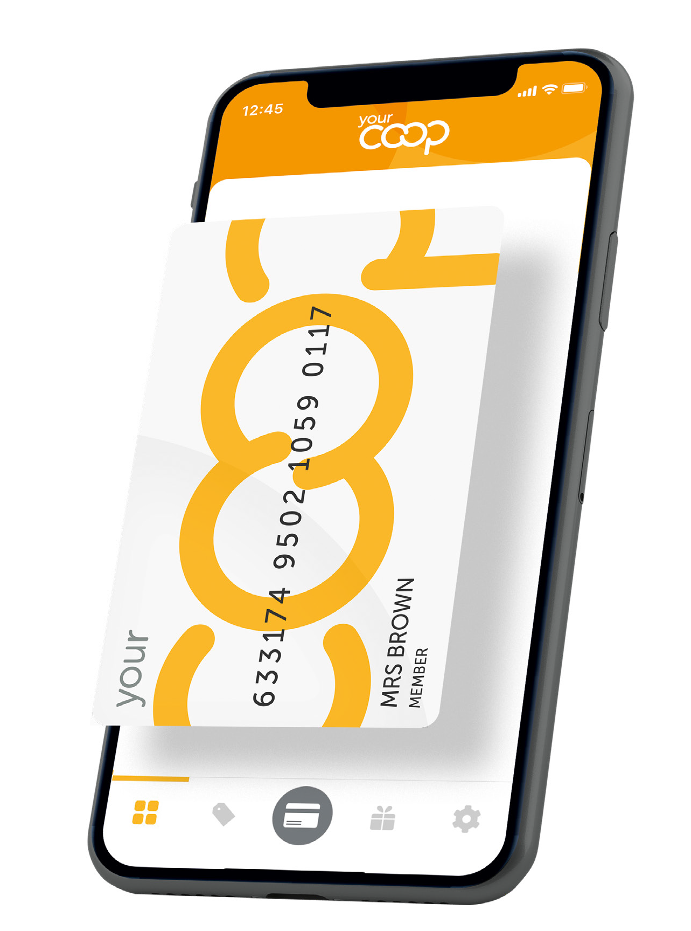
Membership makes the difference
September 2021
Notes:
Welcome to your Membership training​

Slide 2
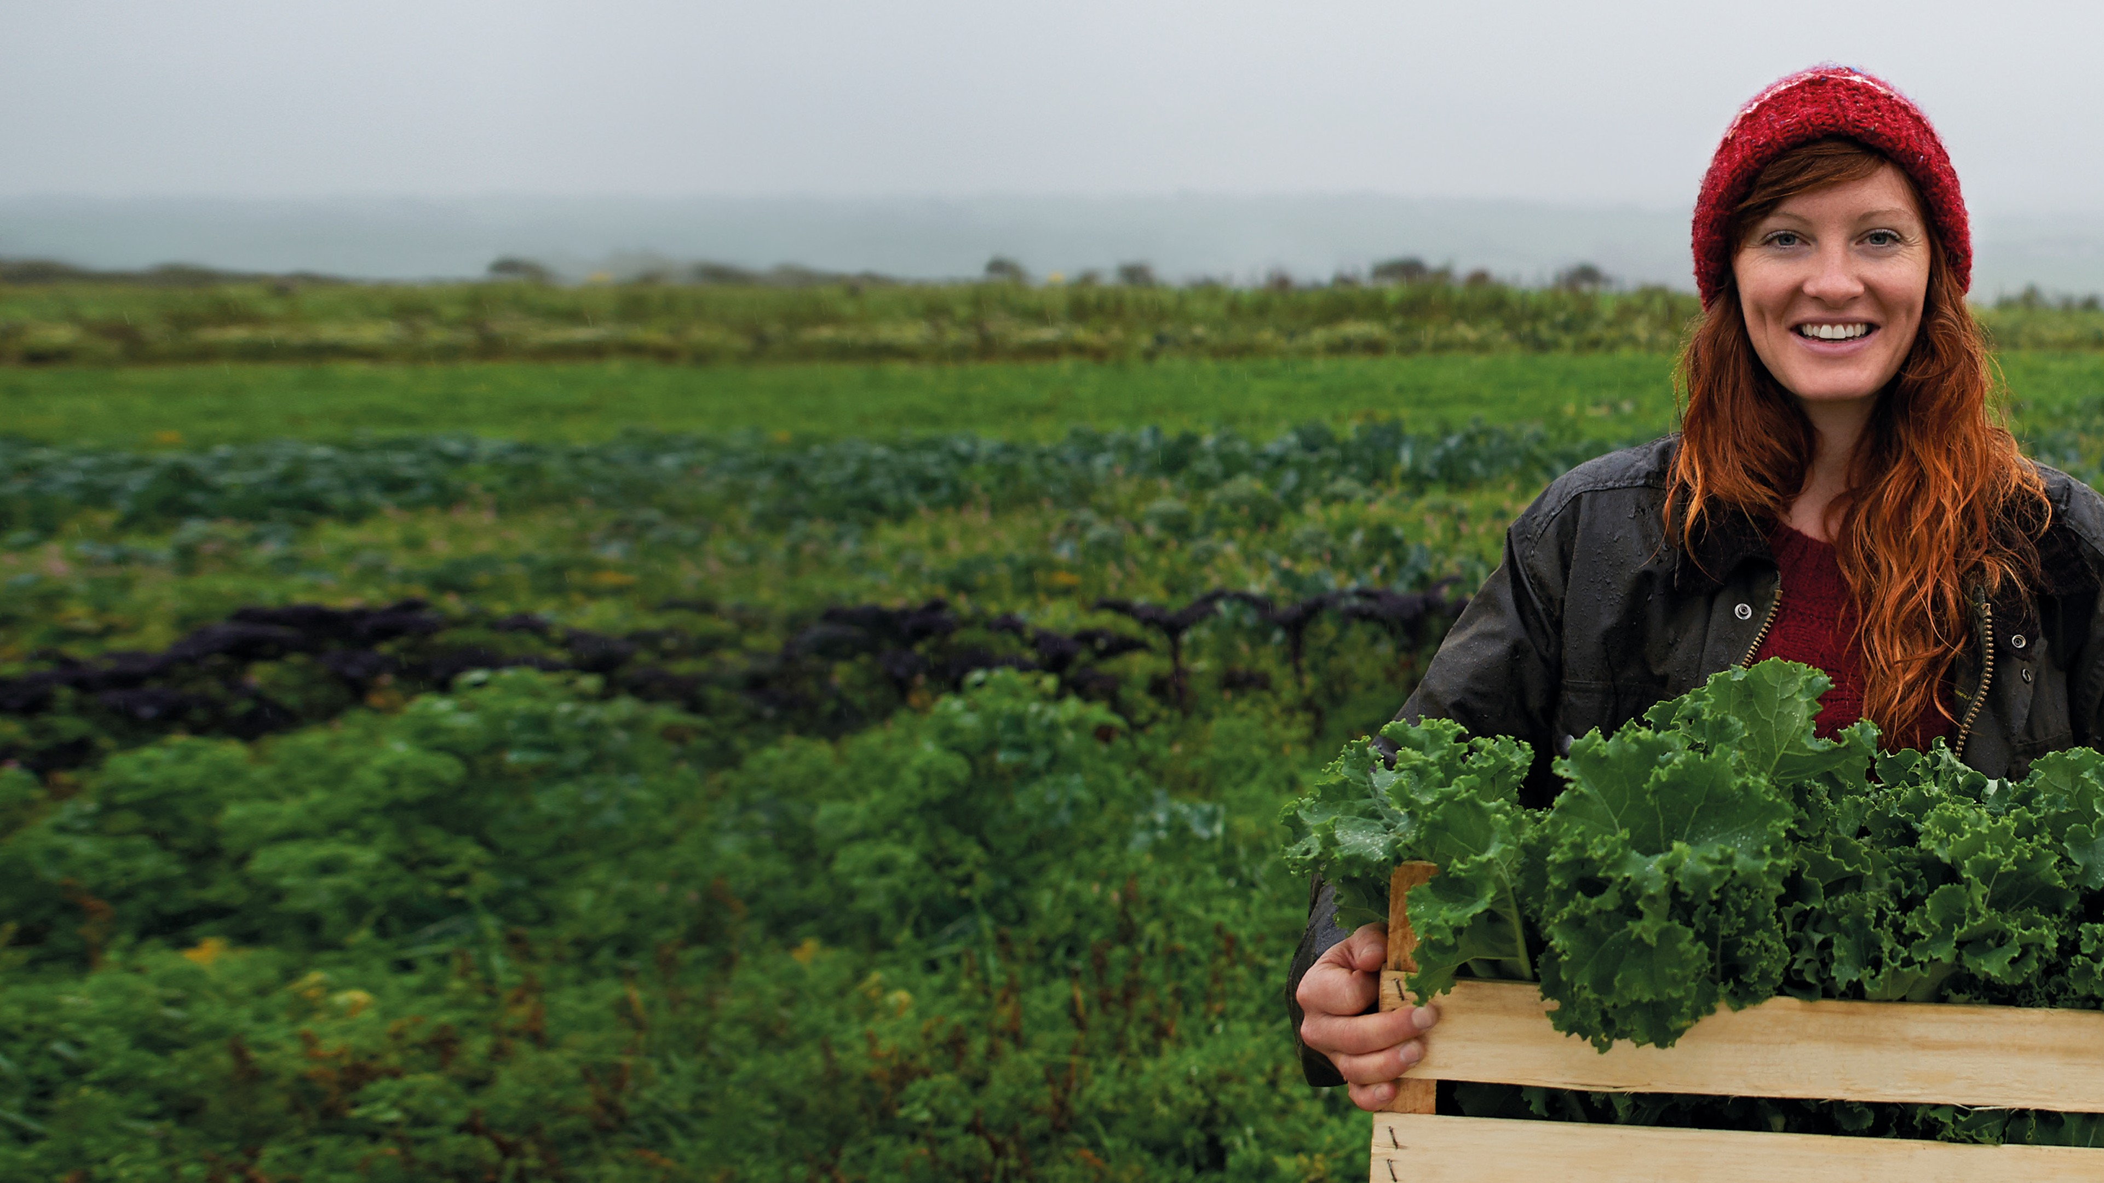
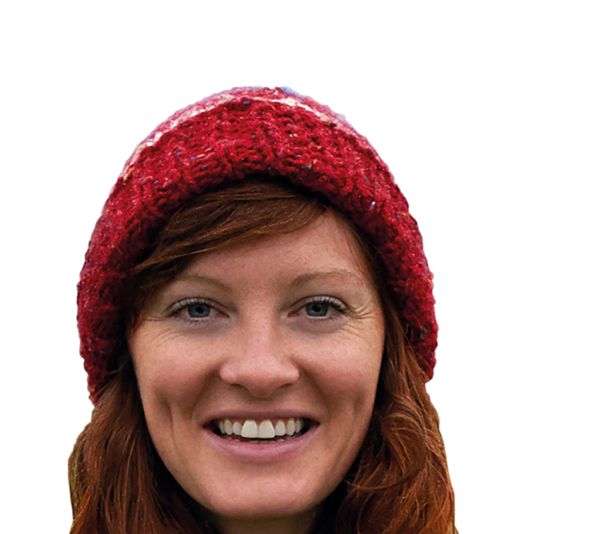
Membership makes the difference
For you, your community and your world
September 2021
Notes:
Membership makes the difference, for you , your community and your world

Slide 3
Contents
What is membership?
Benefits of membership & the app Customer conversations
Finding more information
Notes:
Today's briefing will cover everything you need to know about membership and Your Co-op members app​
​
More information about membership​
Benefits for membership and the App​
Having great conversations​
Where to find more information
​

Slide 4
Your Membership
We are not like other retailers. We are a co-operative, which means we are owned by our members and run for their benefit.
That means being a member needs to feel special - more than just being a customer. This is their Co-op.
Our members are at the heart of everything
we do to grow our business.
Notes:
Your Membership Recap -
Midcounties is a consumer Co-operative owned and controlled by its members. We are part of the global Co-operative movement and subscribe to Co-operative values and principles that govern all Co- operatives around the world. ​
​
Our purpose is simple but ambitious with Co-operative values at its heart – what we do with our profits -
We share with our members
Invest back into our local communities
Invest back into our business. ​
​
We are not like other retailers. We are a Co-operative – which means we are owned by our members and run for their benefit. ​
And that means being a member needs to feel special – more than just being a customer. This is their Co-op.​
Our members are at the heart of everything we do to grow our businesses. ​
​
Why do we need members​?
Members Trade with us which in turns makes us profit​
Members take an Interest in our other Trading Areas promote and shop with us​
Members can share their views through AGM/ member conversations and half yearly meetings​
Members campaign with us​
Members become our ambassadors, promote others to trade with us​
Members play an active role in our Society​
Let’s take a look at our membership benefits and what it has to offer and what it means for our member’s ​

Slide 5
Benefits of your membership…
Your Share of the Profits
Your Member share
accounts
Your Community
AGM/
Your Co-op conversation
Your Member discounts
5
Notes:
Membership makes a difference -Benefits of Membership ​see how membership makes a difference
Share of the profits​ which means -
We reward our members by sharing our profits with them the value is dependent on the profit made​, making our members feel valued for the everyday ways they spend with us, the more they spend within our family of business groups the more they will benefit from membership. colleagues should talk and promote membership during each transaction. ​
​
Members can choose to use their share to spend in any of our business groups, pay it into their share account, or donate to charity​ for example credit their energy or phone bill, redeem in our Food, Childcare, Travel and online Pharmacy, or pay into their share account and withdraw when needed.
​
Member exclusive discounts - which means! Value
Our members in some of our Food stores have – 10% discount known as Diamond discount 60 plus, (the member should ask for the discount) mem
In Travel members receive great rates and better exchange on Travel money. ​
​
In Healthcare (online) our members receive 10% discount on all non-prescription items as well as a member’s rate for the online DR service giving members peace of mind when travelling abroad​.
​
Share Accounts - which means our members are shareholders, they can invest in and earn interest on balances over £10, invest a maximum of £100,000., it’s easy to sign up they simply call the share ledger team at Head Office, 0800 435 902 (select option 4), and they’ll do the rest!​
https://www.midcounties.coop/membership/member-investments/share-account/ ​
We believe in the value of supporting the communities where we trade and getting Involved​ which means
Members can apply for grant schemes for their local communities £250, these grants are available throughout the year. ​
​
Members take part in for example, litter picking, donating to our Food banks, being part of our regional communities, members and colleagues working together to support their local community, local charities and volunteering together to help build strong local communities. this is a great way to give back to our members and customers. ​
​
Annual General Meeting which means members are invited to actively have a say on how the business is run, explain what they want, an opportunity for them to have a vote on key decisions for their Society, find out more how we are performing (unlike many businesses).
We also have Half yearly meetings and member conversations are other ways members can actively get involved with us​ another great opportunity to have their questions answered by the Executives of the business groups, Phil Ponsonby our CEO meet our business senior teams, our fantastic local suppliers to the Young Co-operators within Midcounties a great chance to learn about them and members to ask their own questions. ​
An example of the recent vote on members voted for -the SOTP to be digitalised this was put to the members at out half-yearly meetings, and they voted in favour of it. this is a great example of how our members have a say in how we run. ​
Remember Midcounties is democratically controlled by its members and owned by its members, we are not a PLC we are owned by members​,
we make changes for the better, guided by our values and principals​.
​
​
​
​
​

Slide 6
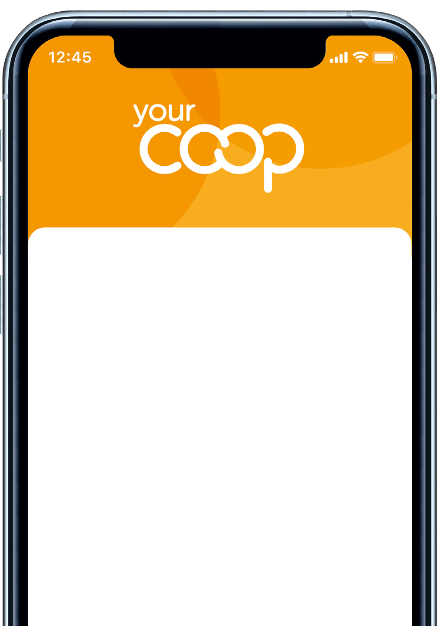
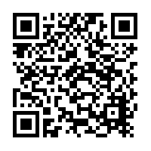
How to download the YCM app
1
Joining is easier with the mobile app. Search for ‘Your
Co-op’ on Google Play or the Apple App Store, or just scan the QR code on the promotional materials in-store.
2
Click on the ‘Register’ link, add your contact details and select your password. Choose online membership to go green and paperless or get your card in the post.
3
You’re done! We’ll send you an email to confirm your membership. You can start using your online app in store immediately.
6
Notes:
How to download the App
Easy access to membership Via the Your Co-op members App easy for customers and members to signs up

Slide 7
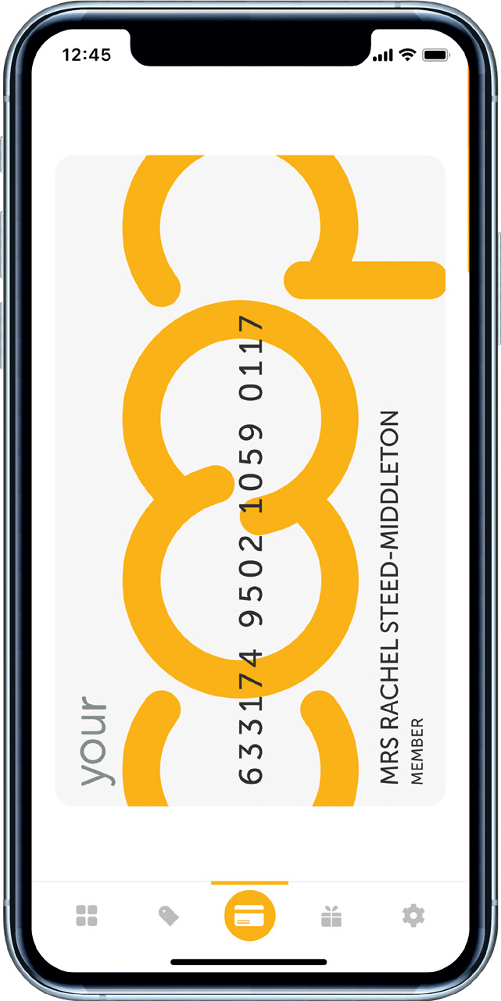
Features and benefits
Your Co-op members app…
If members have the Your Co-op
rewards app, they will
see changes to the app, it’s being redesigned! to enhance the experience
Virtual card – never leave home without it always on hand Access to information such as number of points earned to date Offers and deals in our businesses
Volunteering opportunities
Share instant feedback on your recent visit Community updates
Business updates
Customers can sign up via the app
7
Notes:
Features and Benefits of the Your Co-op members App
Talk through the features and benefits for the Your- Co-op members App and why customers and members should download the App
Easy access to membership –
Virtual card – never leave home without it always on hand​
Access to information such as number of points earned to date​
Offers and deals in our businesses​
Volunteering opportunities​
Share instant feedback on your recent visit​
Community updates​
Business updates​
Customers can sign up via the App​
If members already have the Your Co-op rewards app, they will see changes to the App, it is all being redesigned, to make it easier for our members

Slide 8
“Can I scan your membership card? or Can I take your membership number please?”
Notes:
Treat every customer as a potential member. Make them feel they are missing out.
Customer facing roles -
Every customer should be prompted for their membership card and number encourage our customers to become members and members to cross trade with us
Management roles –
Ensure your teams are having these conversations we want to increase our membership to have
Wider range and access to membership
Increase our membership
Trade more with our businesses

Slide 9
“YES” I am a member
“Did you know, we are a family of businesses where you can also earn points?” “Do you have the Your Co-op members app? its easy to download which means with your virtual card to hand you never miss out on earning points”
“Are you making the most of your membership?”
“Did you know that you can download the Your Co-op members app and have access to your digital card view our latest offers, business updates, feedback on your experience for your recent visit , and book on to the next Your Co-op conversations?”
“All the information to hand”
“Don’t forget you also get member benefits as well as other deals such as member currency rates with our Travel, download the Your Co-op members app and you can find all the information even some volunteering opportunities and updates on our community work”
“Don’t forget can also earn points by being, involved and have a say in how we run our business by taking part in our members conversation and attending our AGM, book via Your Co-op members app take a look”
Notes:
Customer is a member – conversation
All colleagues must ask the customer for their membership card or number
Remember practice makes perfect as long as we ask all our customers for their membership card or number, you can reply with what comes more naturally to you!
“Did you know, we are a family of businesses where you can also earn points?” ​
​
“Do you have the Your Coop Members App? it’s easy to download which means your virtual card to hand you never miss out on earning points” ​
“Did you know that you can download the Your Co-op Members App, and have access to your digital card view our latest offers, business updates, feedback on your experience of your recent visit, and much more”
“All the information to hand” ​
“Don’t forget as a member you have member benefits, as well as other deals, such as member currency rates with our Travel business, download the Your Coop members App, where you can find all the information, even some volunteering opportunities”
“Don’t forget can also earn points by being, ​
involved and have a say in how we run our business by taking part in our member's conversations and attending our AGM, book via Your Co-op members App take a look”
Remember practice makes perfect as long as we ask all our customers for their membership card or number, you can reply with what comes more natural to you! ​

Slide 10
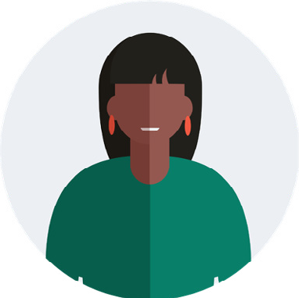
I am not a member
“Sign up today via Your Co-op membership app, It’s quick and easy to become a member download the Your Co-op members app -
You’ll earn points towards our share of profits.
Great opportunities to be involved within your community
And have your say on how the business is run”
“There are many benefits in becoming a member which means that you earn points in our other businesses, you’ll have great member offers, download the Your Co-op members app, and sign up”
”You’ve already spent £… you’re missing out on points, which you can later redeem here or within our other business areas for example towards a holiday, towards your childcare fees, phone or energy bill, download the Your Co-op members app for all of this information and more”
If a customer is unable to download the app, as members they still receive all the benefits membership offers.
Notes:
Customer is not a member- Share some of the conversations
Support and coach colleagues to overcome some of the objection
All colleagues must ask the customer for their membership card or number -
“Sign up today via the Your Coop membership App, it’s quick and easy to become a member, by downloading the App”
“By becoming a member, you will earn points towards our Share of the profits”
“As a member you’ll have great opportunities to be involved within your community”
“You get to have a say on how the business is run, when you become a member”
“There are many benefits in becoming a member which means that you earn points in our other businesses, you’ll have great member offers, download the Your Co-op Members app, and sign up today”
“You’ve already spent £.... you’re missing out on points, which you can later redeem here or within our other business areas for example towards a holiday, or towards your Childcare fees, phone or energy bill”
“Download the Your Coop members App, for more information”
“There are many benefits in becoming a member which means that you earn points in our other businesses also, you’ll have great member offers, download the Your coop members App, and sign up today”.
Tips
Don’t forget if the customer is in a hurry refer them to our website https://www.midcounties.coop/ or encourage them to download the App where they can sign up and find out more information about membership and how they can make the most of it
Some customers may seem to be in a hurry, have a quick conversation while you are processing their transaction.
If a customer is unable to download the App, or do not want too, may not have a smart phone as members they still receive all the benefits, membership offers.

Slide 11
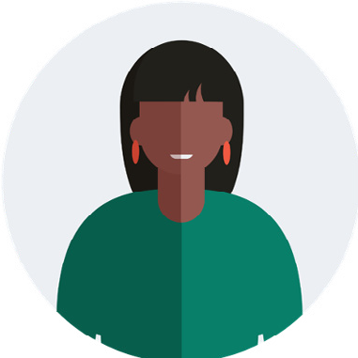
Why should I …?
“You’re the only Midcounties here so I can only earn points from you?”
“I have this card but it’s different to yours”
”Download Your Co-op members app, I don’t have a smart phone and I don’t want too”?
“There are many ways you can still earn points, here are some examples
utilities – broadband, mobile phone contract, online healthcare”
“You can be a member of more than one Co-operative please note the dates of distribution of share of the profits will differ from Co-operatives”
“That’s ok, we understand even if you don’t download the app, you still have access to the all of the benefits, the app, helps to have all the information in one place”
Please remember… even though your site maybe out of a trading area, members can still utilise their membership and earn points in other ways
Notes:
Handling customers questions
Why Should I?
(Managers to role play) allow colleagues to have a go!
Practice
You may come across some questions, and may need to have some additional conversations with your members and non-members for example -
“You’re the only Midcounties near me, so I can only earn points with you”
“There are many ways members can still earn points, here are some examples, within our Utilities business if a member signs up to broadband, or even mobile phone contract, they earn points throughout their contract.”
Remember… even though a member may not have many Midcounties sites nearby, members can still make the most of their membership in other ways…
Members can trade and earn points through our Healthcare website, book a holiday with Travel, can be done online you don’t have to be in a Midcounties area this will help members and non-members see how membership can be meaningful for them.
“I have this card and it’s different to yours”
You can be a member of more than one Co-operative Society; however, you are missing out on points with us, as well as exclusive member offers and discounts, having a say in how Midcounties run”
I don’t have a smart phone or don’t want to download the App
If a customer/ member is unable to download the app or does not want too, reassure them, they still benefit from all membership benefits and offers.

Slide 12
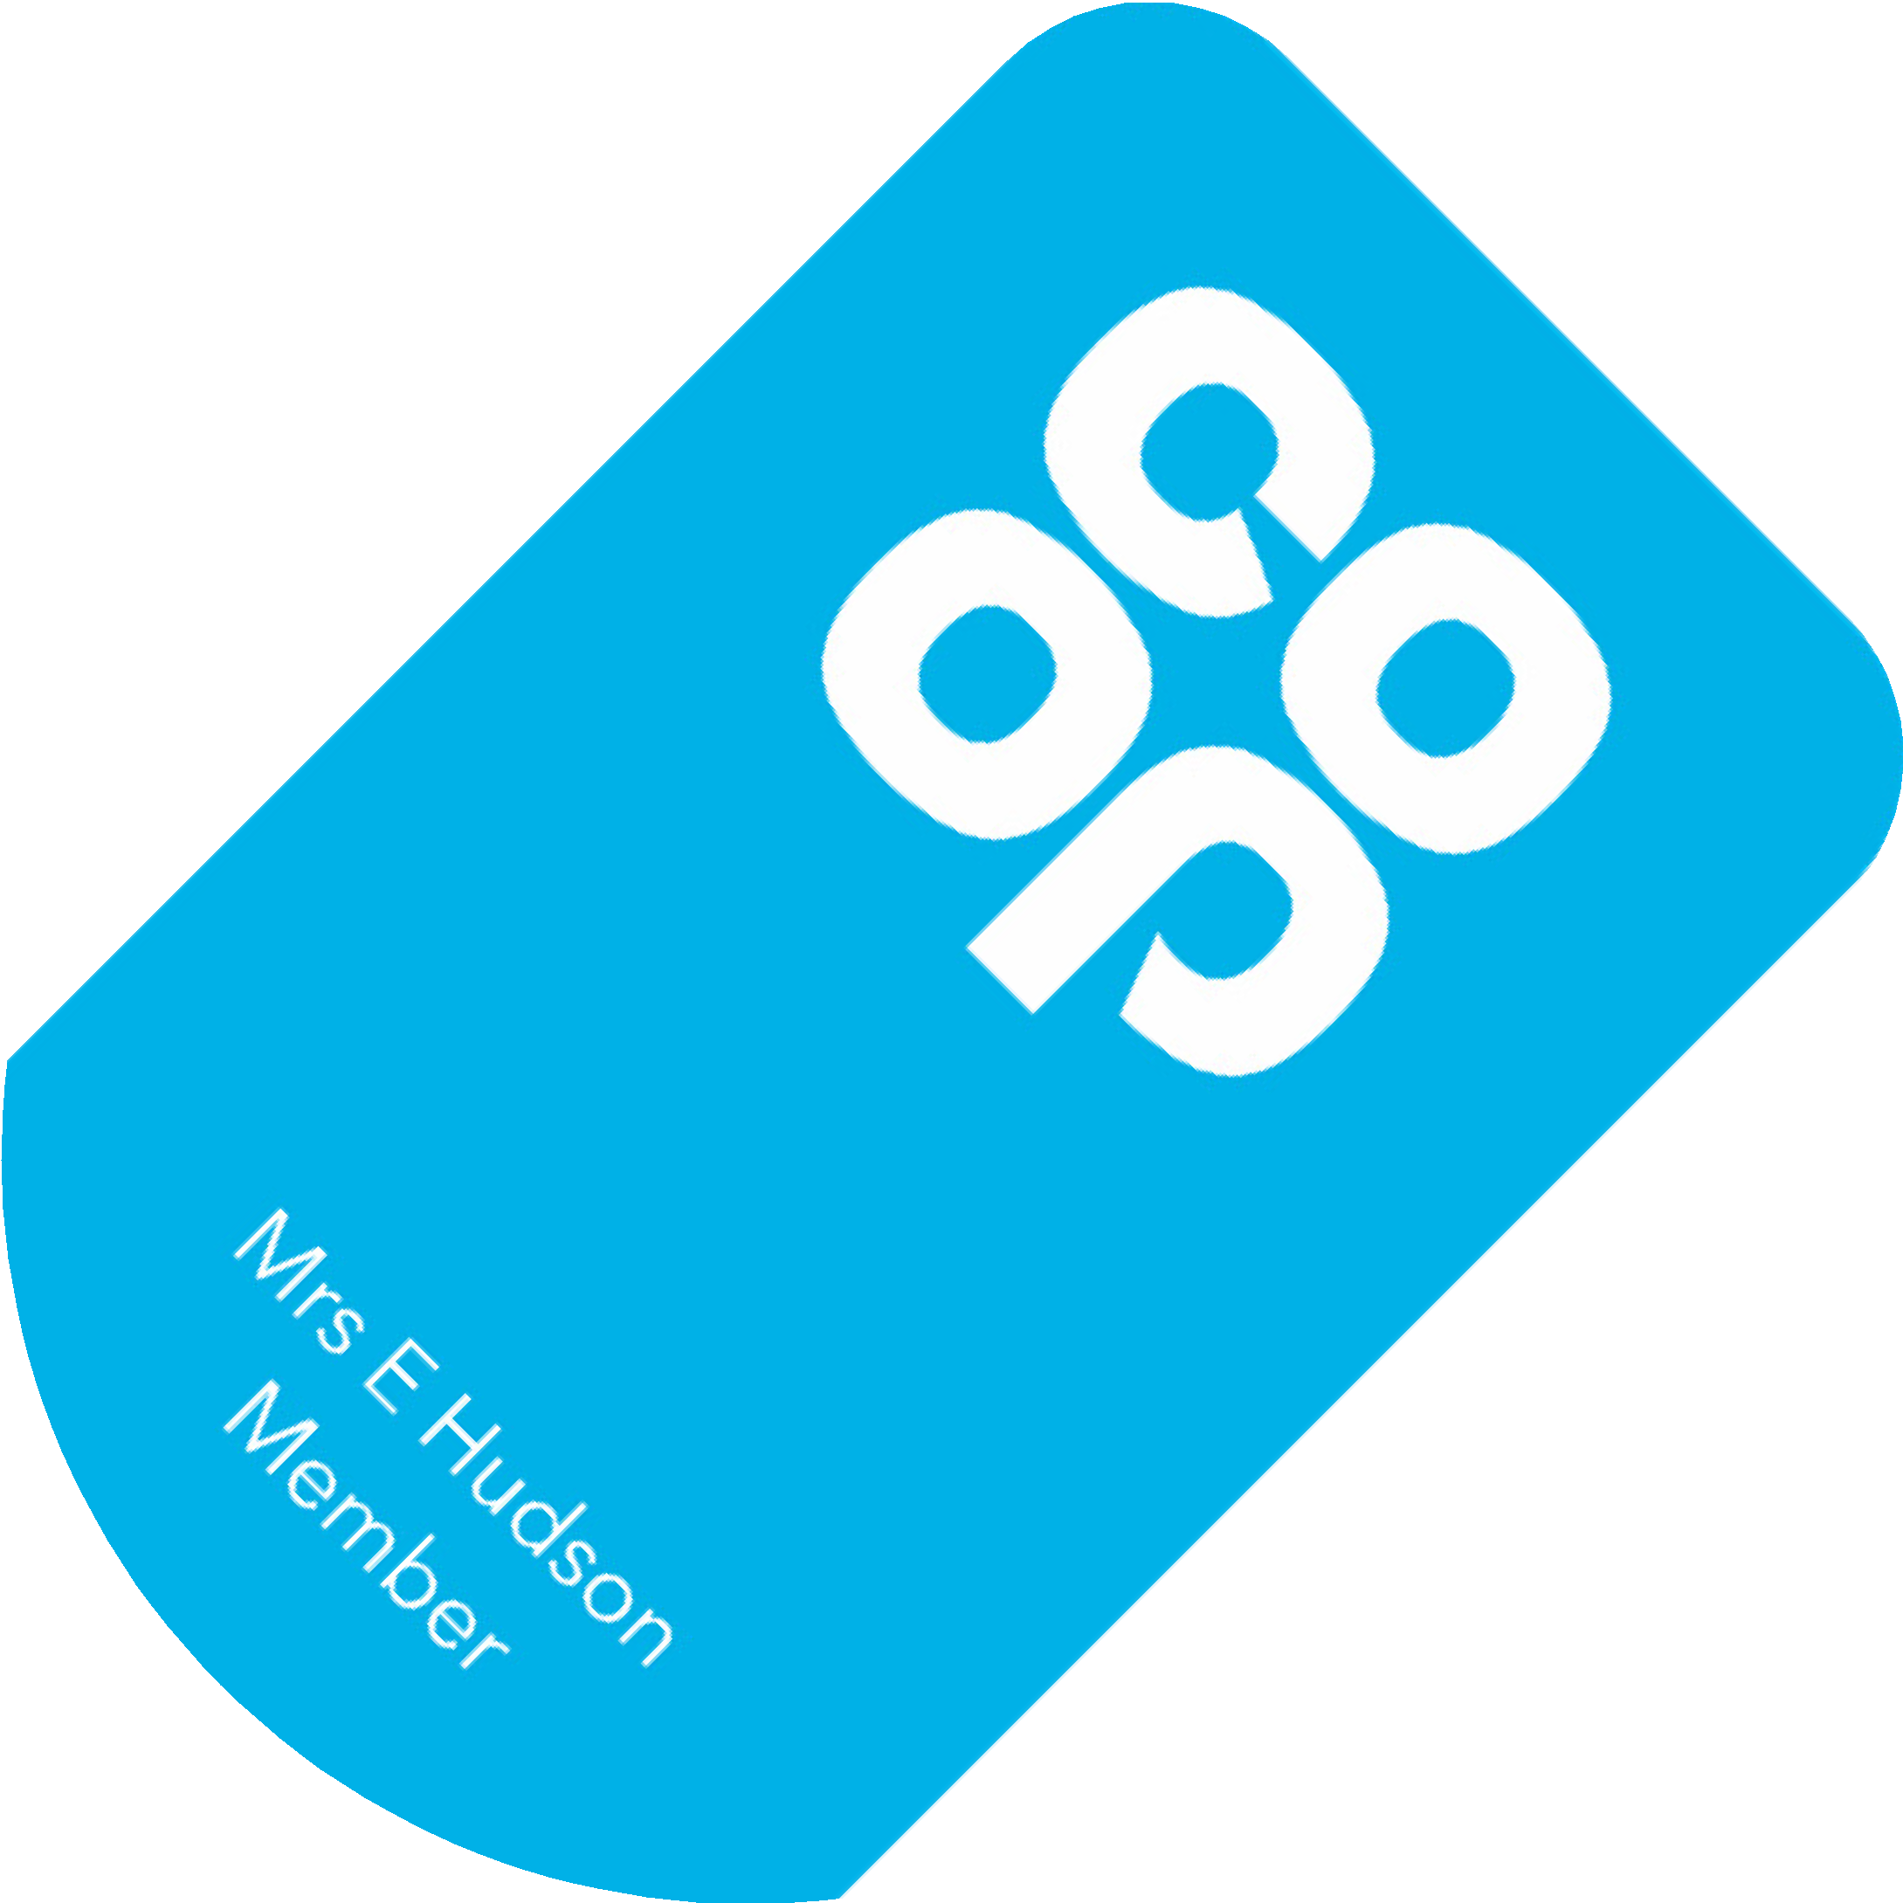
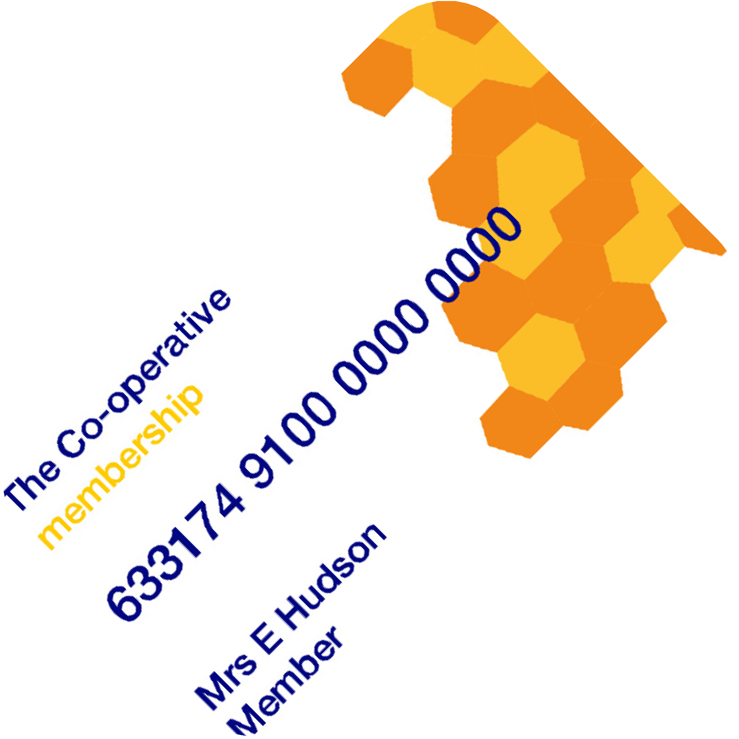
Other types of cards/apps
You may see other types of Co-operative membership cards and Apps, such as these shown below. If a customer presents a different membership card - like those shown below -
you should still introduce our membership
The Co-operative Group
Central England
Chelmsford Star
Notes:
Other types of cards colleagues may come across
We work closely with other Co-operatives for example Central England, The Co-operative Group and Chelmsford Star where we have partnered enabling members and colleagues to earn points and discounts.
If a customer presents a different membership card/ number, you can still
Customer Member (non Midcounties) scan or enter the membership number they will earn membership points based on Midcounties rewards points system
Colleague Member (non Midcounties) – scan or enter the membership number, they will earn membership points based on Midcounties rewards points and receive their discount rate of the owning Co-operative in this case Midcounties
In summary
Membership card/ number will work in the same way
Earn membership points on purchases made with us as we can in these Co-operative outlets - (Central England Co-operative, Chelmsford Star Co-operative
Points are converted into a dividend-based on profits accrued (points earned equivalent to the individual Co-operative rewards).
As a colleague receive a discount rate of the owning Co-operative where the transaction was made.
Still introduce our membership and explain how they are missing out on Midcounties membership benefits, share some examples -
Diamond discount, - 10% Diamond Day every Tuesday if 60 or over and a member will only apply in selected Co-op Midcounties Food stores.
Great travel currency rates in Travel 10% Online Healthcare
Attend our Annual general meeting – have a say, vote on key decisions.
Half yearly – Your Coop conversations – meet the Executives, suppliers

Slide 13
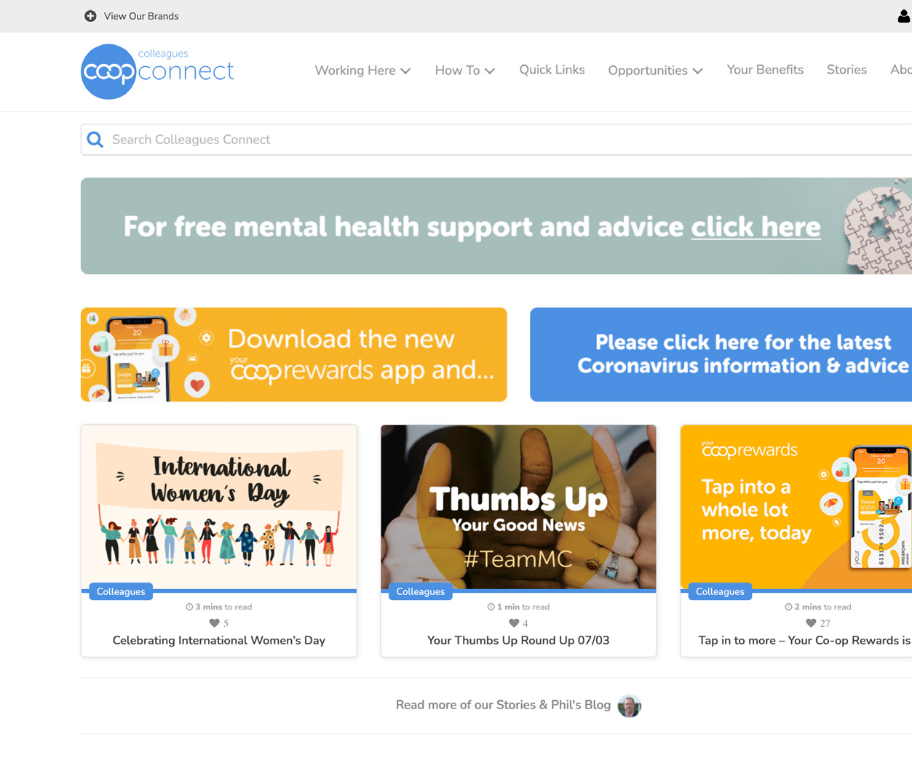
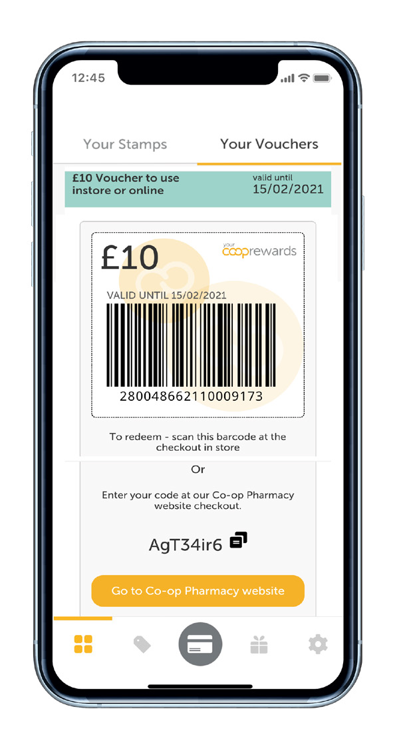
How can a customer sign up to become a member?
Via the Midcounties membership
websitewww.midcounties.coop/membership/signup
In branches - Colleague sign
upwww.midcounties.coop/membership/signup/1nst0re
In Food Stores - Colleague using the
member sign up function on the HHT’s
Call the membership team on 0800 435 902
Sign up via the Your Co-op members App
Notes:
Methods in which customers can sign up
There are several ways in which customers can sign up to become Midcounties members
If you’re in Travel/ Childcare/ Utilities use the branch sign up site https://www.midcounties.coop/membership/signup/1nst0re/? This should be the site all sites use. It does require an email address. If customer has no email, they are asked to use option 3. see below.
Customers can download the Your Co-op members App and sign up
Customers can also sign up from home via our website they will need to verify their email details and set up a password. https://www.midcounties.coop/membership/signup/
If the customer does not have an email address, they can call membership team, on 0800 435 902 and the membership team can sign them up.
Some Food stores also have the option to sign up through QR codes from the customers receipts and also colleagues can sign customers up with the handheld terminals

Slide 14
Remember!
“Every customer is a potential member.
Always ask if a customer is a member when processing their transactions.”
Notes:
Every customer is a potential member, always ask if a customer is a member when processing their transactions
Recap – Why wouldn’t they want to be part of our amazing business
Members can sign up via the Your Co-op members App, and have access to all information regarding their membership and Midcounties
Membership is important because our members run the society, this allows them to have a voice vote say on their business
Earn points which vary to our business groups
Members trade with us and take an interest in our business area’s
Members can campaign with us

Slide 15
What you need to do
Set the scene - Colleagues must talk about membership and the YCM members App
Encourage colleagues to prompt for membership card or number with every transaction and have conversations about the Your Co-op members App
Observe colleagues and give just in time feedback
Brief your teams and share and direct them to additional resources
Notes:
What you need to do next
If you are the briefing manager, these are next steps you need to take-Membership is a key part of our strategy, and we all need to ensure we play our part if you are a manager
Encourage your teams to talk and promote membership and the Your Co-op members App
Ensure all customers are prompted for a membership card or number, then continue the conversation based on response
Observe and talk to your teams where they have promoted membership really well, also share some conversation tips about membership & the Your Co-op members App.
Ensure all teams are fully briefed and understand the benefits of membership, and the features of the Your Co-op members App

Slide 16
Colleagues Connect:
all your questions answered
We’ve put together more helpful guidance and resources on the Colleagues Connect website.
You’ll find:
Videos
Presentation slides and brief
Notes:
Where you can find more information
Colleagues Connect; All your questions answered.
We have put together more helpful guidance together on Colleagues Connect, where you will find the resources, for example
Video-
The presentation slides and accompanying Brief, to be able to brief your teams in the most effective ways.

Slide 17
Finish the sentence…
A customer approaches and asks… Colleague;
“What are the benefits to joining the Midcounties Co-operative membership?”
“There are many benefits to joining our membership, they are…”
Notes:
Manager to ask the question, ask colleagues to finish the sentence…
A customer approaches and asks, “What are the benefits of becoming a member of the Midcounties Co-operative”.
*Manager to pause and wait for colleagues to respond with their answers*
There are many benefits to joining the Midcounties Co-operative.
Some examples are:
Your Co-op members App all the information to hand
Our members own Midcounties Co-op, meaning we run for their benefit and put them at the heart of everything we do.
Earn points towards Share of the Profits, every time they trade with Midcounties. Which are converted into vouchers yearly. (Pay out depending on profit and points earned)
Have your say- Vote on certain aspects of the business, i.e., who sits on the board of directors etc. Attend our Annual General Meeting
Member exclusive discounts- currency rates in Travel, Diamond discount in food, 10% off online at Co-op Pharmacy.
Give back to the community- apply for grants on behalf of your local community, donate to foodbanks and be involved in organised litter picks events.

Slide 18
A customer phones to arrange a travel booking. During the conversation, he asks about membership
Customer; Colleague;
“I have seen that I can get great
benefits from joining the Midcounties
Co-operative, how can I join?”
“Yes that’s right, you can…”
20
Notes:
Manager to ask the question, ask colleagues to finish the sentence…
A customer phones to arrange a travel booking. During the conversation, he asks about membership.
Customer: “I have seen that I can get great benefits from joining Midcounties Co-operative. How can I join?”
Colleague; “That’s right you can…”
*Manager to pause and wait for colleagues to respond with their answers*
Depending on business
Online by visiting: https://www.midcounties.coop/membership/signup/by phone 0800 435 902
Downloading the Your Co-op members App and signing up
Food – Handheld Terminals, selected sites have QR codes on their receipts.
Travel - Super Divi system
Utilities – website/ telephone
Healthcare – website
Funeral – Super Divi

Slide 19
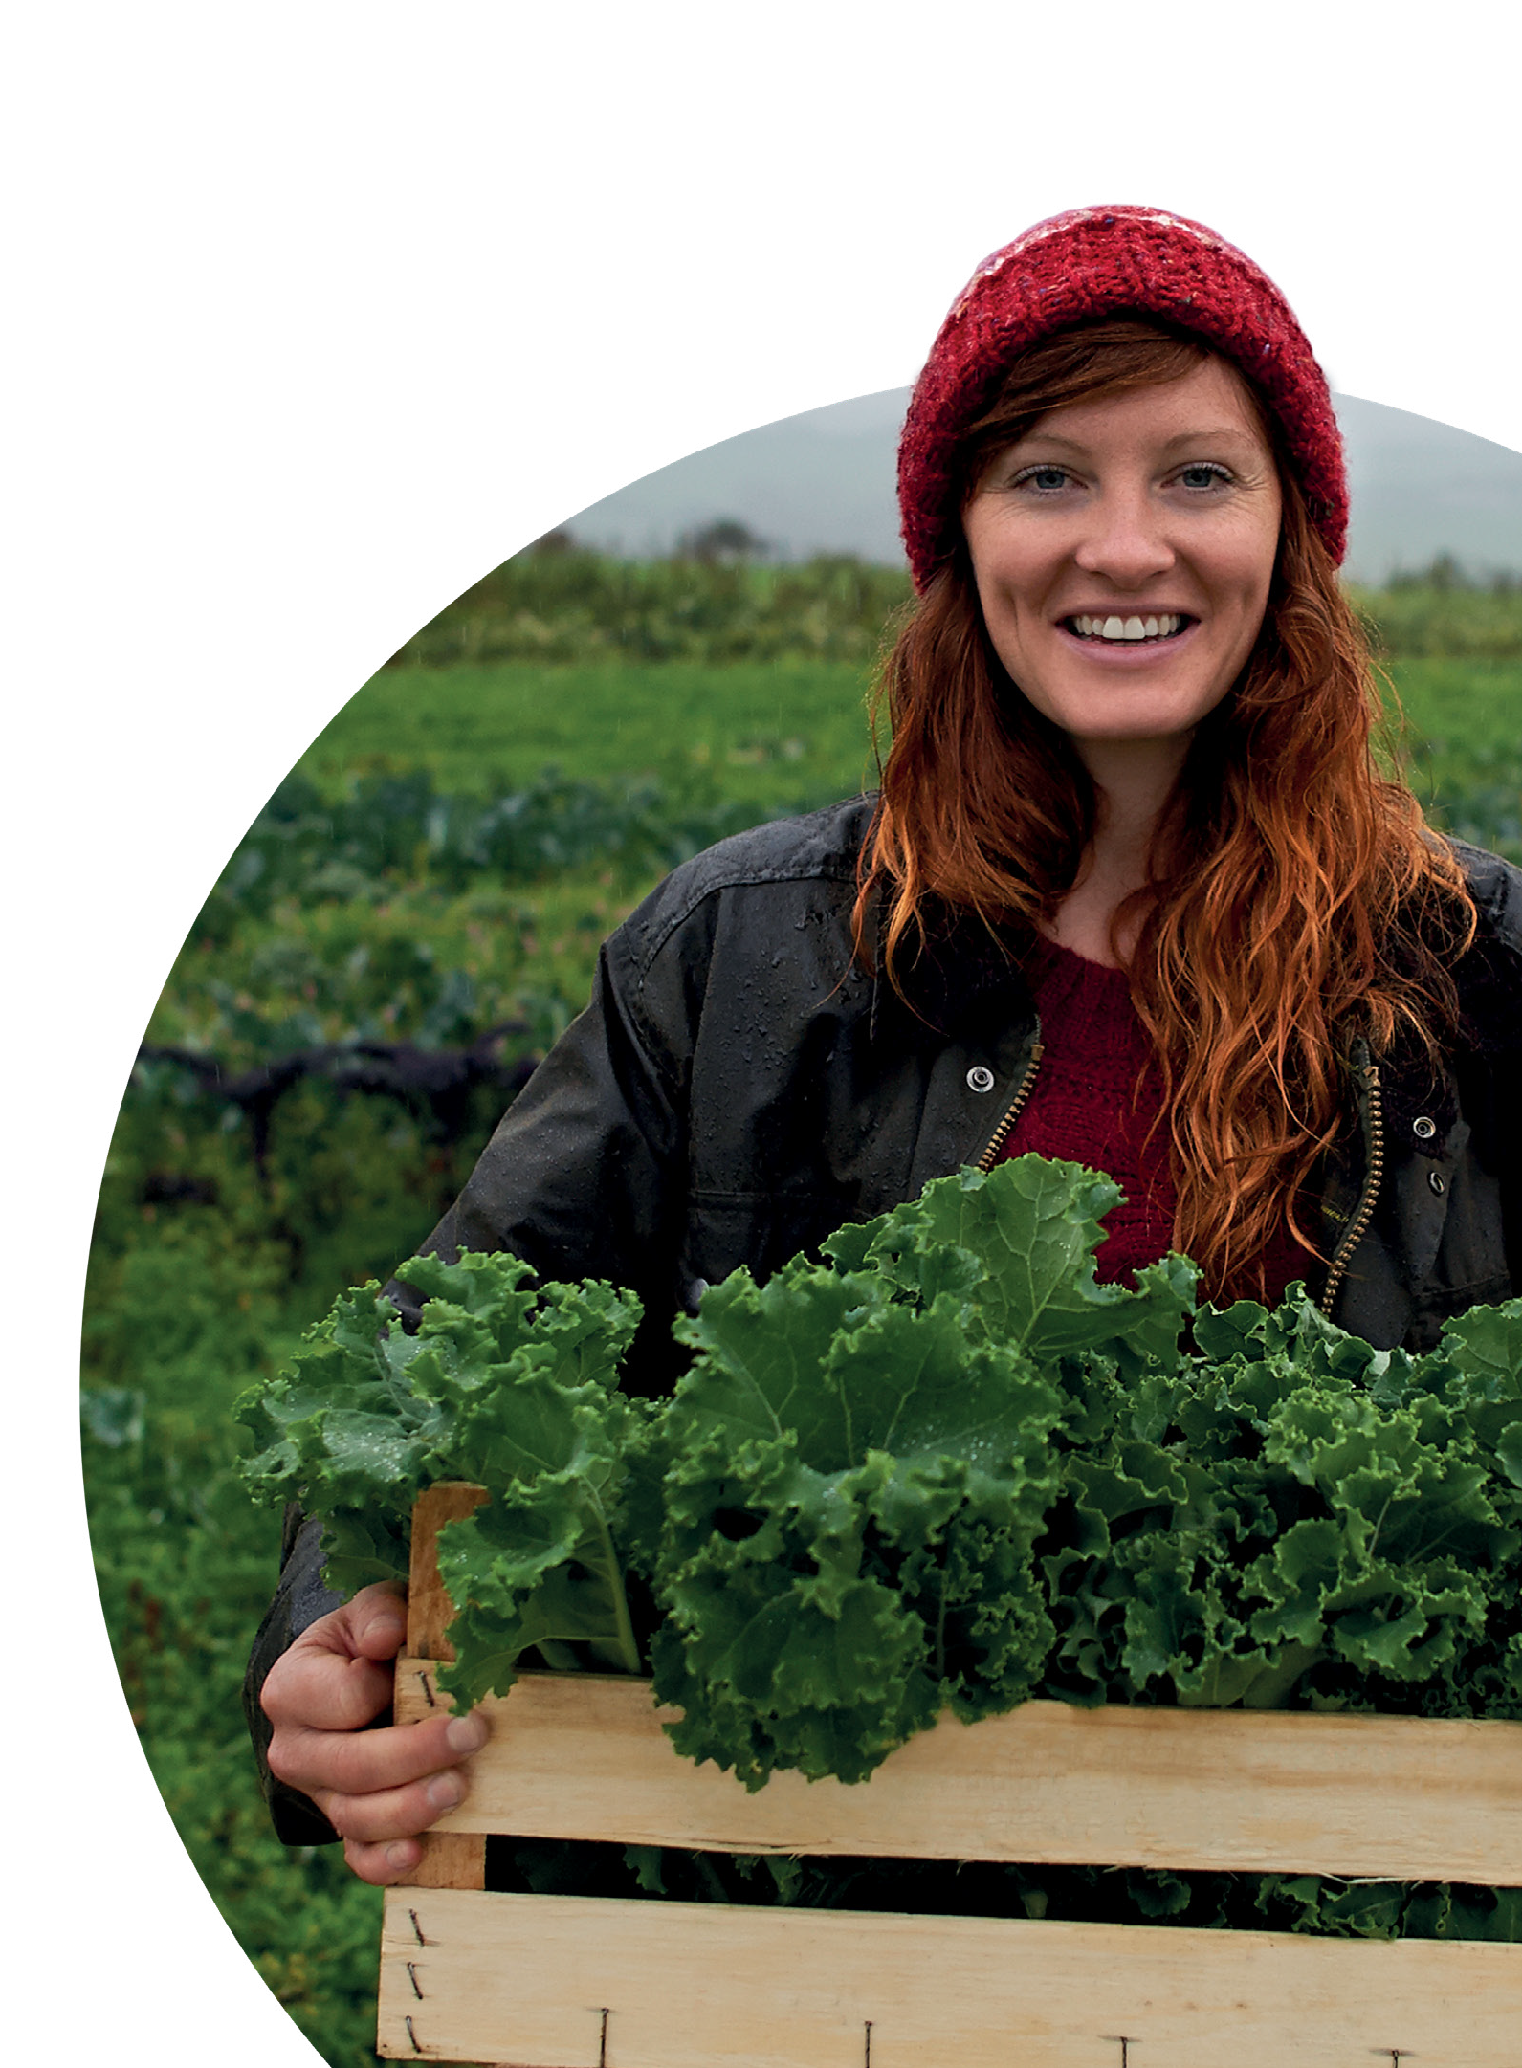
Summary
Here’s what we just covered – designed to help you understand:
Membership, Your Co-op member app and benefits
Different types of conversations Your roles and responsibilities
Where to locate additional resources
Notes:
Summary
Finish by summarising what we have covered
Membership Your Co-op Members App
Different types of conversations
Roles and responsibilities
Where to locate additional resources

Slide 20
Thank you
Notes:
Thank you for listening/ reading our ambition is to increase our membership thank you for supporting us with our journey and driving it forward.
•Wider range and access to membership
•Increase our membership
•Trade more with our businesses

