Slide 1
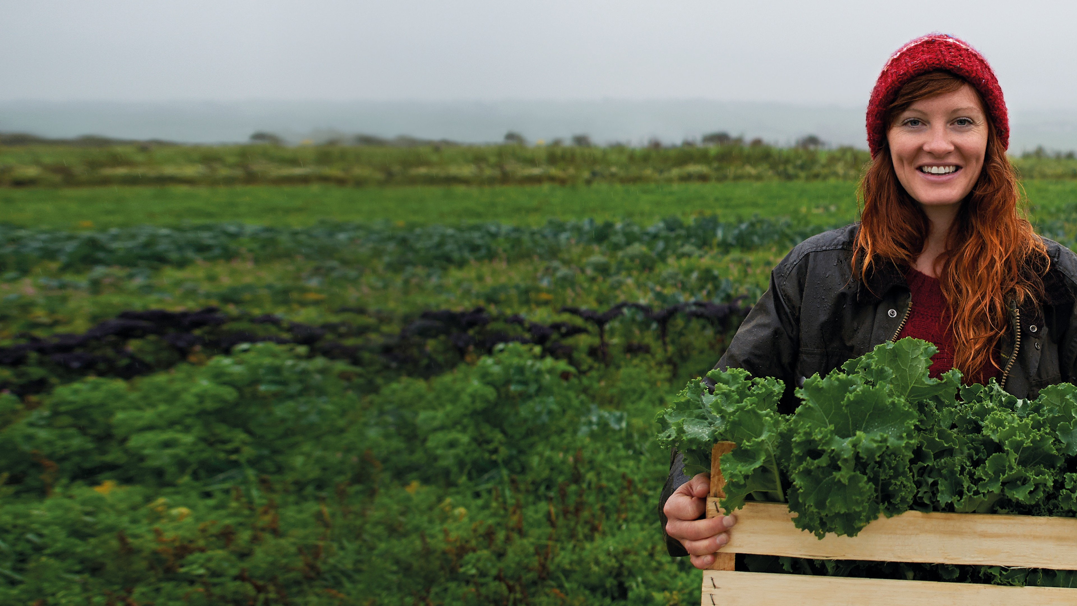
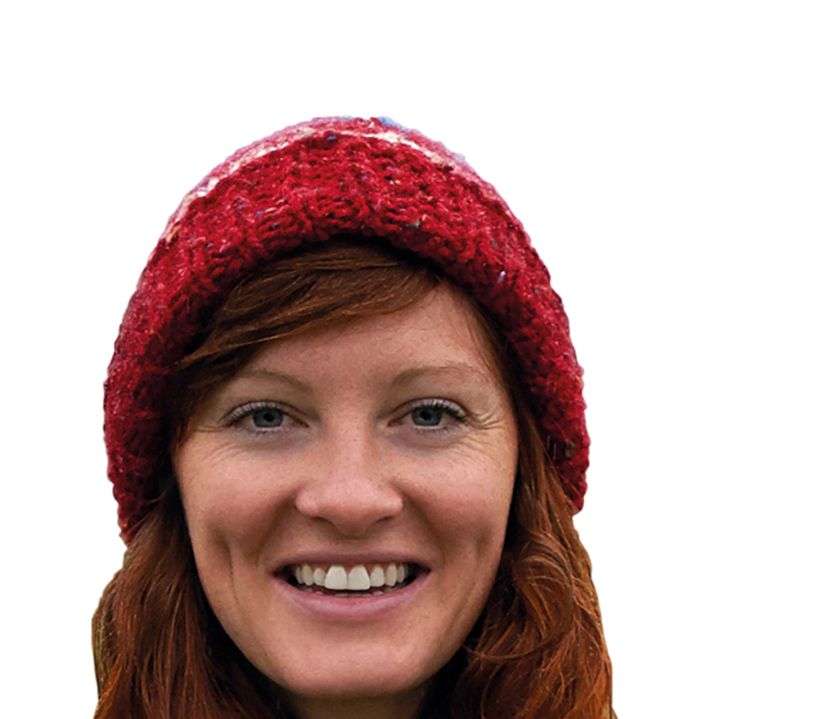
Membership makes the difference
For you, your community and your world
Notes:
Welcome to your Membership training
Membership makes the difference, for you , your community and your world

Slide 2
Contents
What is membership?
Benefits of membership & the app Customer conversations
Finding more information
Notes:
Today's briefing will cover everything you need to know about membership and Your Co-op members app​
​
More information about membership​
Benefits for membership and the App​
Having great conversations​
Where to find more information
​

Slide 3
Your Membership
We are not like other retailers. We are a co-operative, which means we are owned by our members and run for their benefit.
That means being a member needs to feel special - more than just being a customer. This is their Co-op.
Our members are at the heart of everything
we do to grow our business.
Notes:
Your Membership Recap -
Midcounties is a consumer Co-operative owned and controlled by its members. We are part of the global Co-operative movement and subscribe to Co-operative values and principles that govern all Co- operatives around the world. ​
​
Our purpose is simple but ambitious with Co-operative values at its heart – what we do with our profits -
We share with our members
Invest back into our local communities
Invest back into our business. ​
​
We are not like other retailers. We are a Co-operative – which means we are owned by our members and run for their benefit. ​
And that means being a member needs to feel special – more than just being a customer. This is their Co-op.​
Our members are at the heart of everything we do to grow our businesses. ​
​
Why do we need members​?
Members Trade with us which in turns makes us profit​
Members take an Interest in our other Trading Areas promote and shop with us​
Members can share their views through AGM/ member conversations and half yearly meetings​
Members campaign with us​
Members become our ambassadors, promote others to trade with us​
Members play an active role in our Society​
Let’s take a look at our membership benefits and what it has to offer and what it means for our member’s ​

Slide 4
Benefits of Your membership…
Your
Your
Member Discounts;
Your
Member Share Accounts;
Say;
Community;
Your
Your
Share of the Profits;
Earn points for every time you spend across our trading groups towards the share of the profit vouchers
Have access to exclusive member only offers and deals, such as; diamond discount available in selected food stores, member exclusive exchange rates in Travel., 10% discount on non-prescription items on Healthcare online.
We enable our members to support our regional communities, where members and colleagues work together to support the local community. Members are able to get involved with organised events, such as; litter picking, donating to food banks and organised community events.
Midcounties is owned by it’s members, our members have a say in how we run. They can have their say by attending the Annual General Meetings, voting on who sits on our board of directors, attending our Co-operative conversations meetings with the COO’s of our trading groups and many more.
Our members are shareholders of the Midcounties Co-operative, they have the opportunity to invest in Midcounties, members can earn interest on balances over £10 and invest a maximum of £100,000.
Notes:
Benefits of Membership
Share of the profits
Lets take a look at the benefits of membership – we reward our members by sharing our profits with them the value is dependant on the profit made
And that begins by making them feel valued for the everyday ways they spend with us., in return they receive the share of profits, earn points by trading with us, the more they spend within our business groups the more they will benefit from membership, colleagues should talk about membership during each transactions.
This year the share of the profits were distributed digitally first time and this was voted for by our members.
Members can choose to use their share to spend in any of our trading groups, pay it into their share account, or donate it to charity​ for example credit their energy or phone bill, donate to charity, or pay in to their share account and withdraw when needed, redeem in our Food, Childcare, Travel and online pharmacy.
Member discounts Other benefits Food -Diamond discount 60 plus, 10% discount this is in selected Food stores,(the member should ask for the discount) member’s also have great rates, better exchange on Travel money.
Online Healthcare members receive 10% discount on all non prescription items as well as a members rate for the online DR service giving members peace of mind when travelling abroad, and purchase sun cream excluding VAT
Share Accounts -Members are shareholders of The Midcounties Co-operative, our members have the opportunity to invest in Midcounties, members can earn interest on balances over £10 and invest a maximum of £100,000., it’s easy to sign up simply call the share ledger team at Head Office, 0800 435 902 (select option 4), and they’ll do the rest!
https://www.midcounties.coop/membership/member-investments/share-account/
We believe in the value of supporting the communities where we trade and also about getting Involved
Members can apply for grant schemes for their local communities £250, these grants are available throughout the year.
Community - members to give back to the community by being involved in litter picking with us and encouraging our members to donate to our Food banks, we also enabled our members to support within our regional communities, enabling members and colleagues to work together to support the local community this is a great demonstration of our co-operative difference. This includes supporting local charities and volunteering together to help build strong local communities. this is a great way to give back to our members and customers, - profits invested back into our communities, share our profits with our members and invest back in to the Midcounties
Annual General Meeting that we invite our members to actively have a say on how the business is run ,explain what they want. It is also the opportunity for them to have a vote on key decisions in their society too and understand where the society is going,half yearly meetings and member conversations are other ways members can actively get involved with us
Remember Midcounties is democratically controlled by it’s members and owned by it’s members, we are not a PLC we are owned by members
In the build up to our AGM we had daily Co-operative conversations over the two weeks prior, for the first time this year. This gave our members the opportunity to have their questions answered by the Executives of the trading groups and Phil Ponsonby this is. new to meet virtually with our business senior teams our fantastic local suppliers to the Young Co-operators within Midcounties a great chance to learn about them and members to ask their own questions.
By being a member, it entitles them to have their say at the AGM - unlike many businesses they have a say in how it’s run help shape Midcounties here are some examples- vote to have their say on lots of topics i.e. who sits on the board of directors, vote on key decisions for example members voted for -the SOTP digitalised this was put to the members at out half yearly meetings and they voted in favour of it this is a great example of how our members have a say in how we run.
All of these benefits colleagues should share with members and non members, when talking about membership
Remember by working with our members we make changes for the better, guided by our values and principals
​

Slide 5
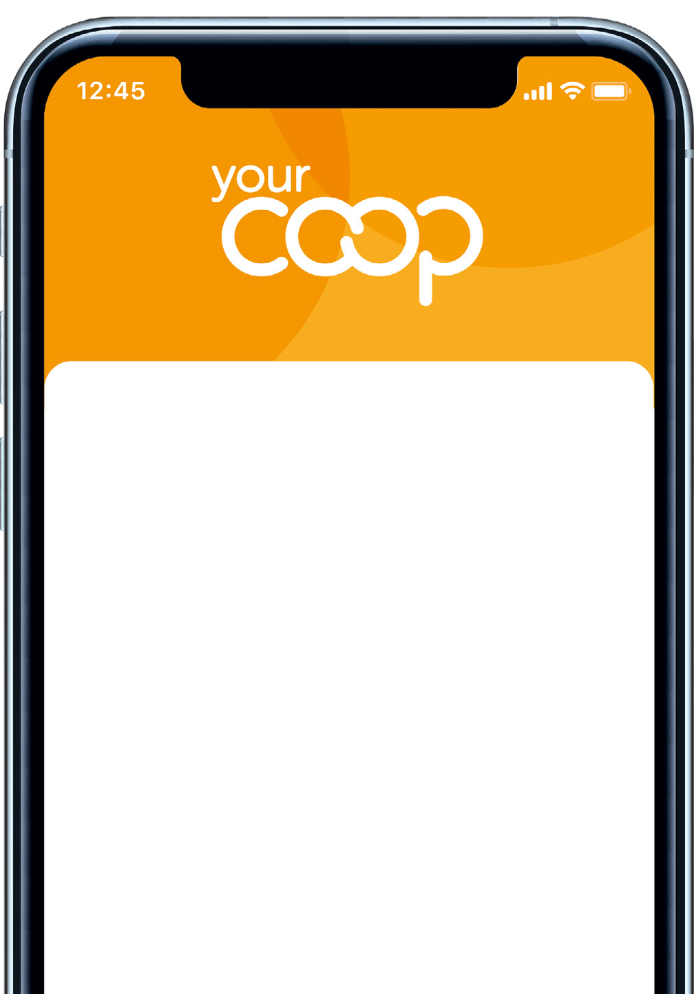
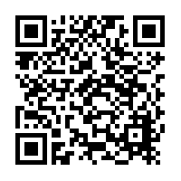
How to download the YCM app
1
Joining is easier with the mobile app. Search for ‘Your
Co-op’ on Google Play or the Apple App Store, or just scan the QR code on the promotional materials in-store.
2
Click on the ‘Register’ link, add your contact details and select your password. Choose online membership to go green and paperless or get your card in the post.
3
You’re done! We’ll send you an email to confirm your membership. You can start using your online app in store immediately.
5
Notes:
How to download the App
Easy access to membership Via the Your Co-op members App easy for customers and members to signs up

Slide 6
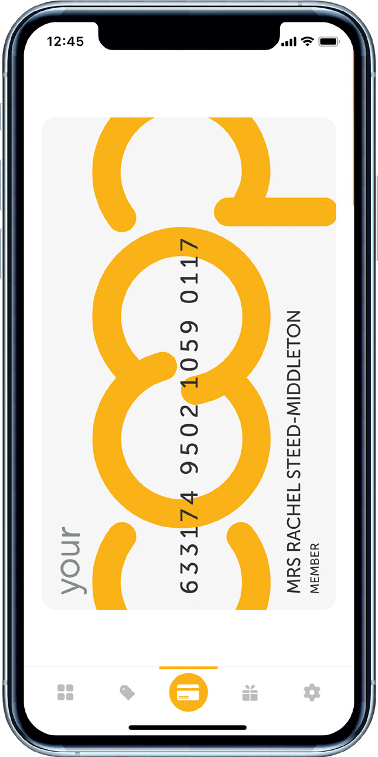
Features and benefits
Your Co-op members app…
If members have the Your Co-op
rewards app, they will
see changes to the app, it’s being redesigned! to enhance the experience
Virtual card – never leave home without it always on hand Access to information such as number of points earned to date Offers and deals in our businesses
Volunteering opportunities
Share instant feedback on your recent visit Community updates
Business updates
Customers can sign up via the app
6
Notes:
Features and Benefits of the Your Co-op members App
Talk through the features and benefits for the Your- Co-op members App and why customers and members should download the App
Easy access to membership –
Virtual card – never leave home without it always on hand​
Access to information such as number of points earned to date​
Offers and deals in our businesses​
Volunteering opportunities​
Share instant feedback on your recent visit​
Community updates​
Business updates​
Customers can sign up via the App​
If members already have the Your Co-op rewards app, they will see changes to the App, it is all being redesigned, to make it easier for our members

Slide 7
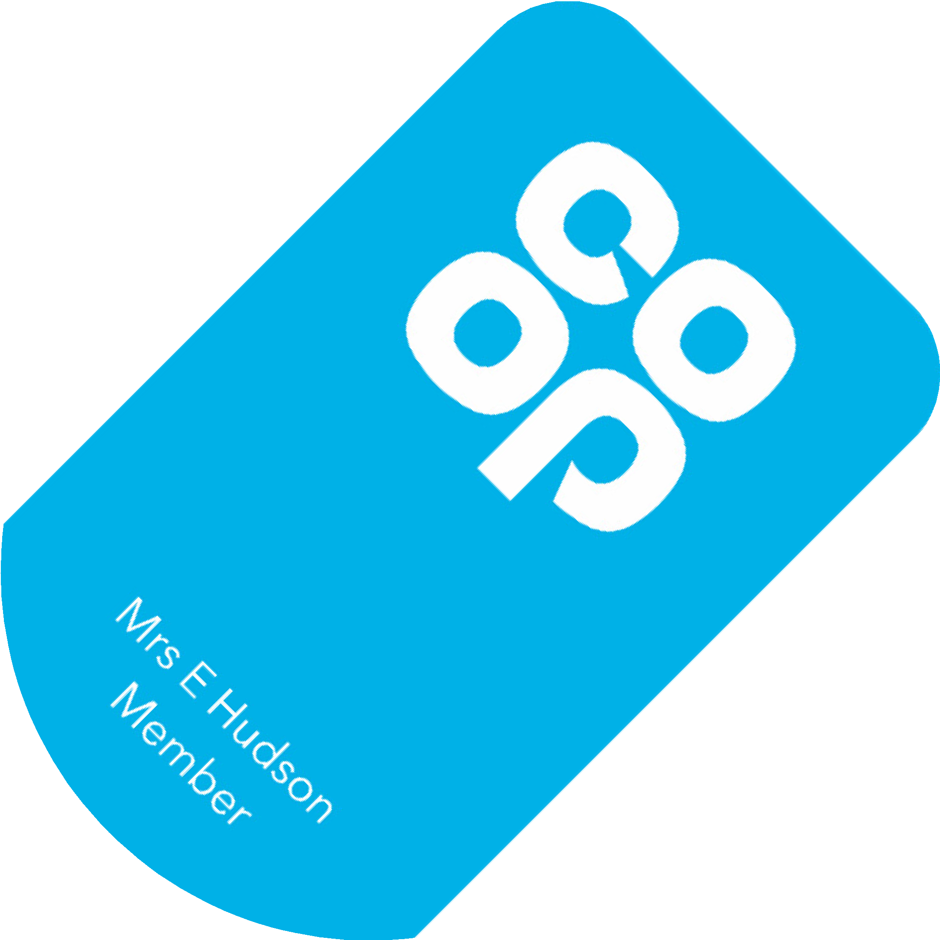
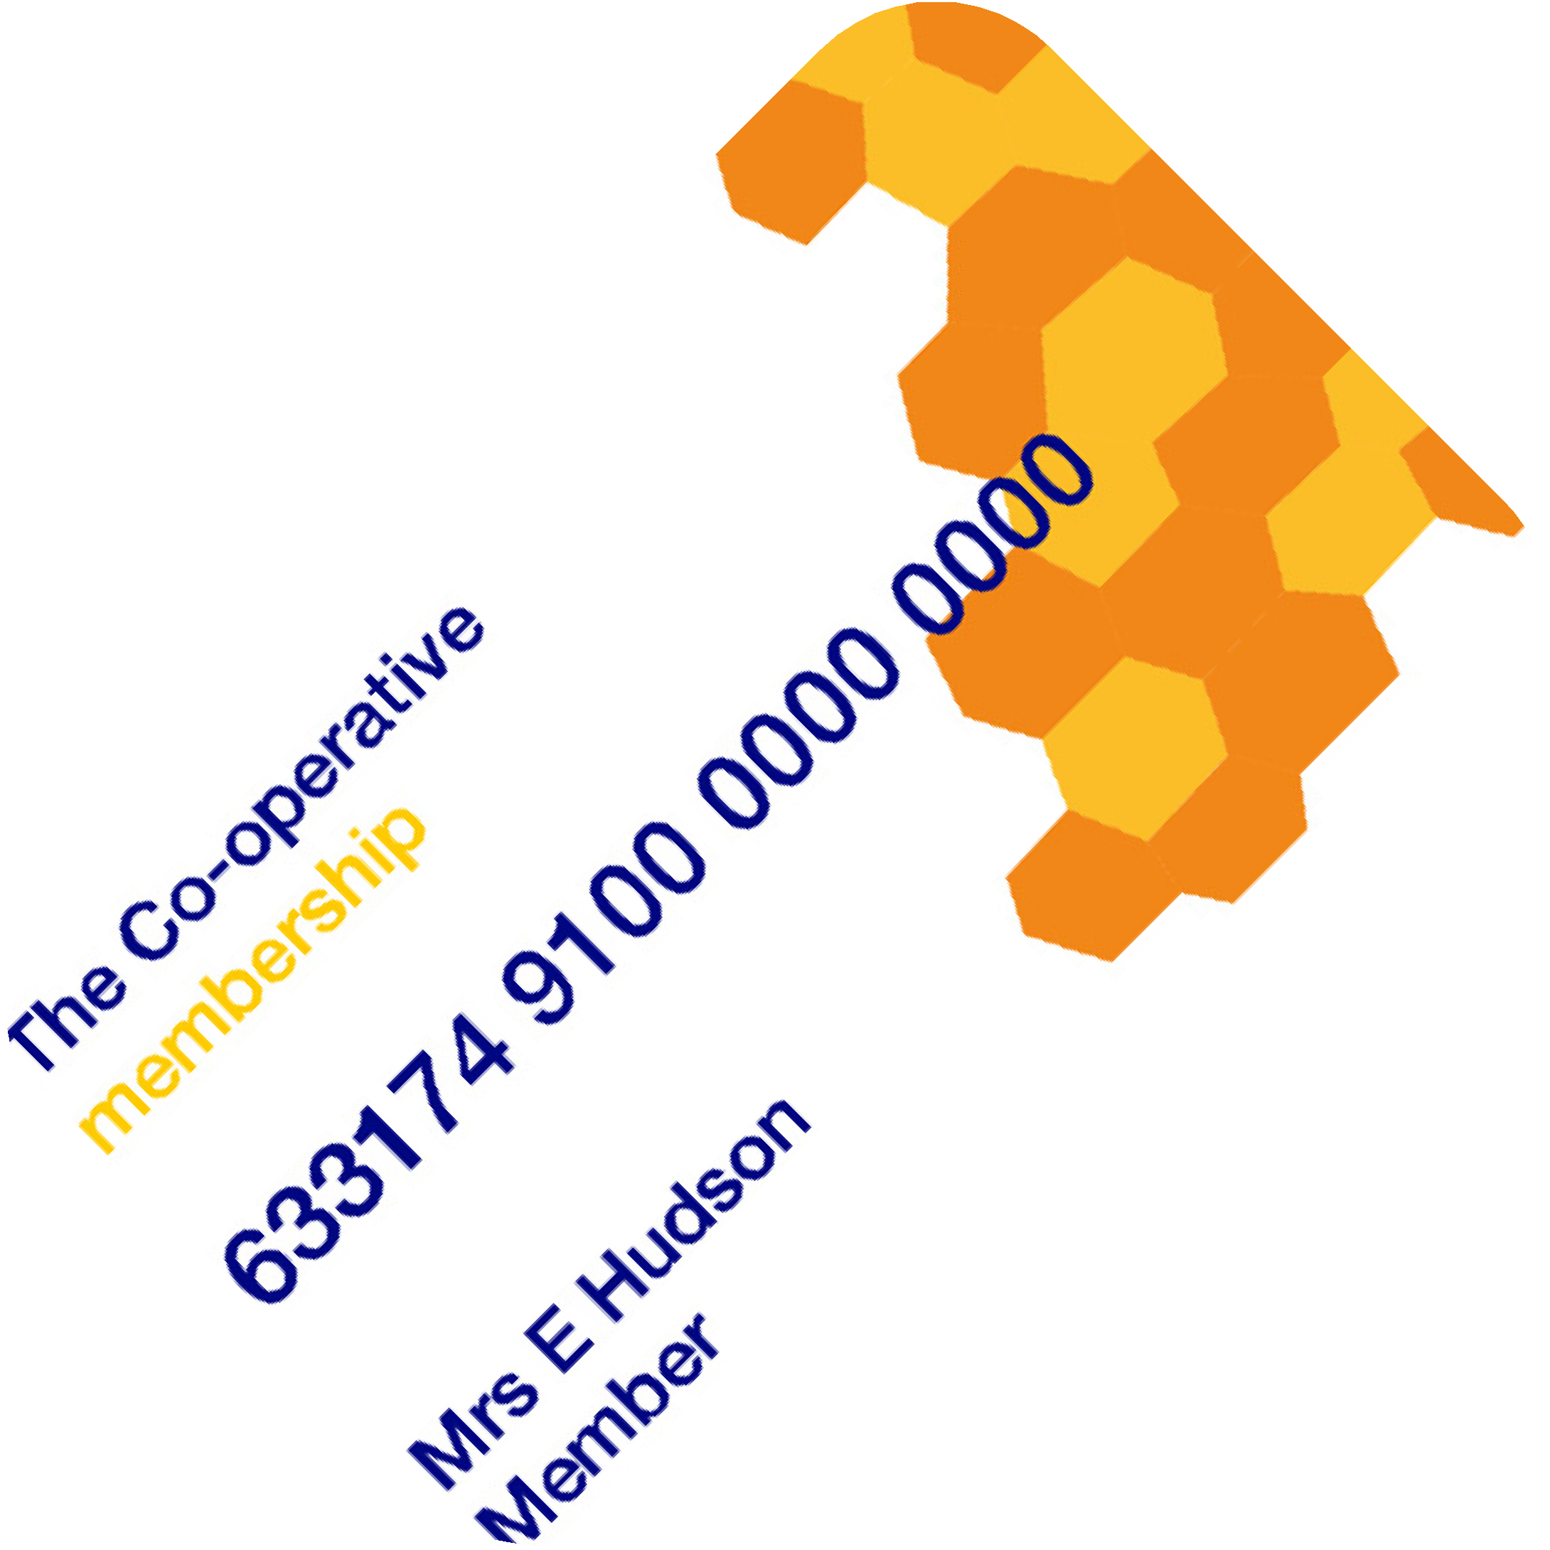
Other types of cards/apps
You may see other types of Co-operative membership cards and Apps, such as these shown below. If a customer presents a different membership card - like those shown below -
you should still introduce our membership
The Co-operative Group
Central England
Chelmsford Star
Notes:
Other types of cards colleagues may come across
We work closely with other Co-operatives for example Central England, The Co-operative Group and Chelmsford Star where we have partnered enabling members and colleagues to earn points and discounts.
If a customer presents a different membership card/ number, you can still
Customer Member (non Midcounties) scan or enter the membership number they will earn membership points based on Midcounties rewards points system
Colleague Member (non Midcounties) – scan or enter the membership number, they will earn membership points based on Midcounties rewards points and receive their discount rate of the owning Co-operative in this case Midcounties
In summary
Membership card/ number will work in the same way
Earn membership points on purchases made with us as we can in these Co-operative outlets - (Central England Co-operative, Chelmsford Star Co-operative
Points are converted into a dividend-based on profits accrued (points earned equivalent to the individual Co-operative rewards).
As a colleague receive a discount rate of the owning Co-operative where the transaction was made.
Still introduce our membership and explain how they are missing out on Midcounties membership benefits, share some examples -
Diamond discount, - 10% Diamond Day every Tuesday if 60 or over and a member will only apply in selected Co-op Midcounties Food stores.
Great travel currency rates in Travel 10% Online Healthcare
Attend our Annual general meeting – have a say, vote on key decisions.
Half yearly – Your Coop conversations – meet the Executives, suppliers

Slide 8
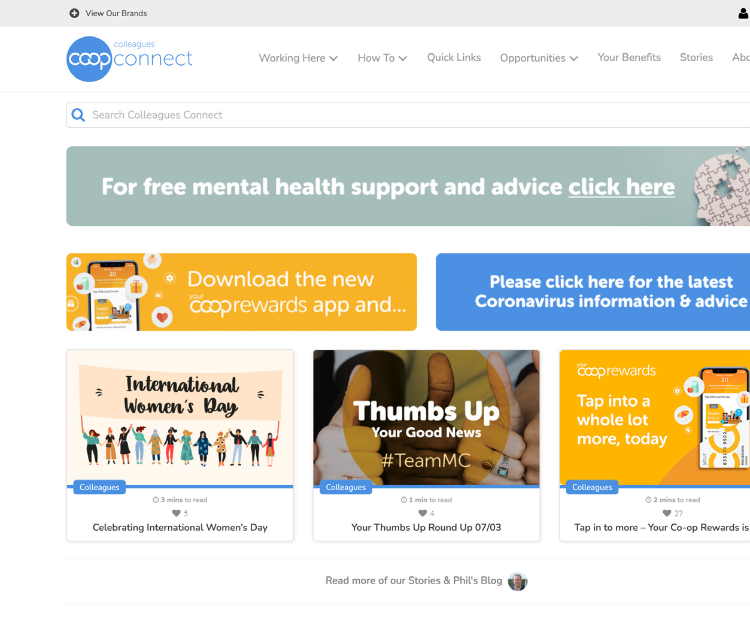
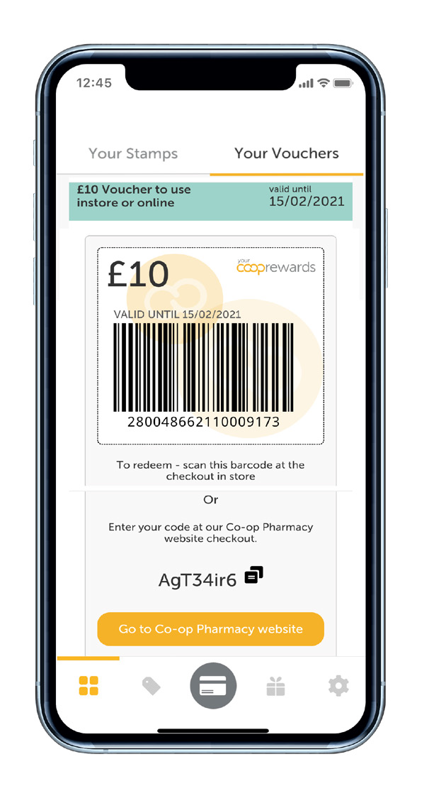
How can a customer sign up to become a member?
Via the Midcounties membership
websitewww.midcounties.coop/membership/signup
In branches - Colleague sign
upwww.midcounties.coop/membership/signup/1nst0re
In Food Stores - Colleague using the
member sign up function on the HHT’s
Call the membership team on 0800 435 902
Sign up via the Your Co-op members App
Notes:
Methods in which customers can sign up
There are several ways in which customers can sign up to become Midcounties members
If you’re in Travel/ Childcare/ Utilities use the branch sign up site https://www.midcounties.coop/membership/signup/1nst0re/? This should be the site all sites use. It does require an email address. If customer has no email, they are asked to use option 3. see below.
Customers can download the Your Co-op members App and sign up
Customers can also sign up from home via our website they will need to verify their email details and set up a password. https://www.midcounties.coop/membership/signup/
If the customer does not have an email address, they can call membership team, on 0800 435 902 and the membership team can sign them up.
Some Food stores also have the option to sign up through QR codes from the customers receipts and also colleagues can sign customers up with the handheld terminals

Slide 9
Remember!
“Every customer is a potential member.
Always ask if a customer is a member when processing their transactions.”
Notes:
Every customer is a potential member, always ask if a customer is a member when processing their transactions
Recap – Why wouldn’t they want to be part of our amazing business
Members can sign up via the Your Co-op members App, and have access to all information regarding their membership and Midcounties
Membership is important because our members run the society, this allows them to have a voice vote say on their business
Earn points which vary to our business groups
Members trade with us and take an interest in our business area’s
Members can campaign with us

