Slide 1


Slide 2
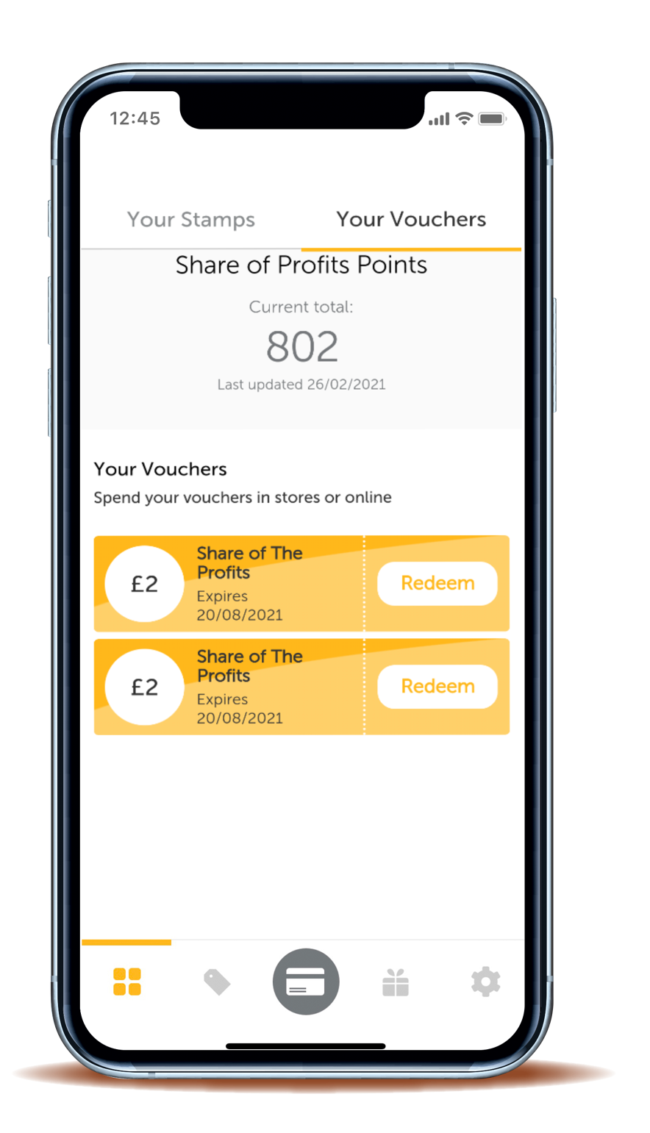

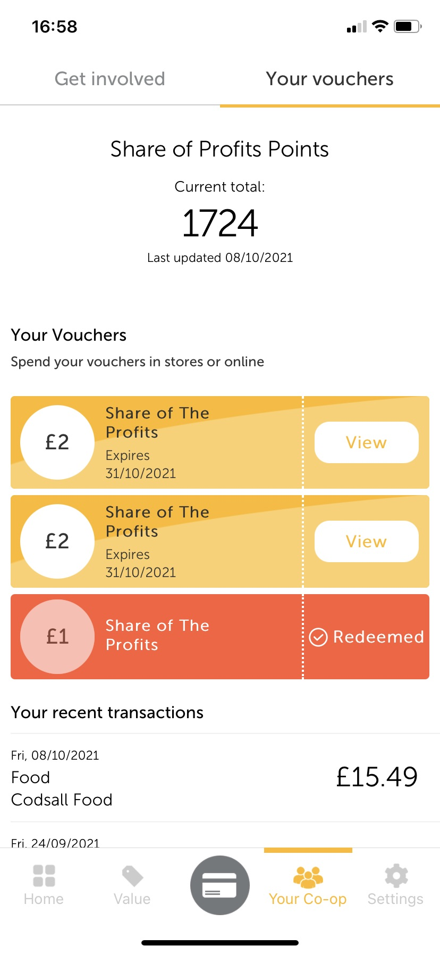
Contents
A quick refresh on Share of the Profits
Where members find their vouchers
How members redeem their vouchers
Finding more information

Slide 3
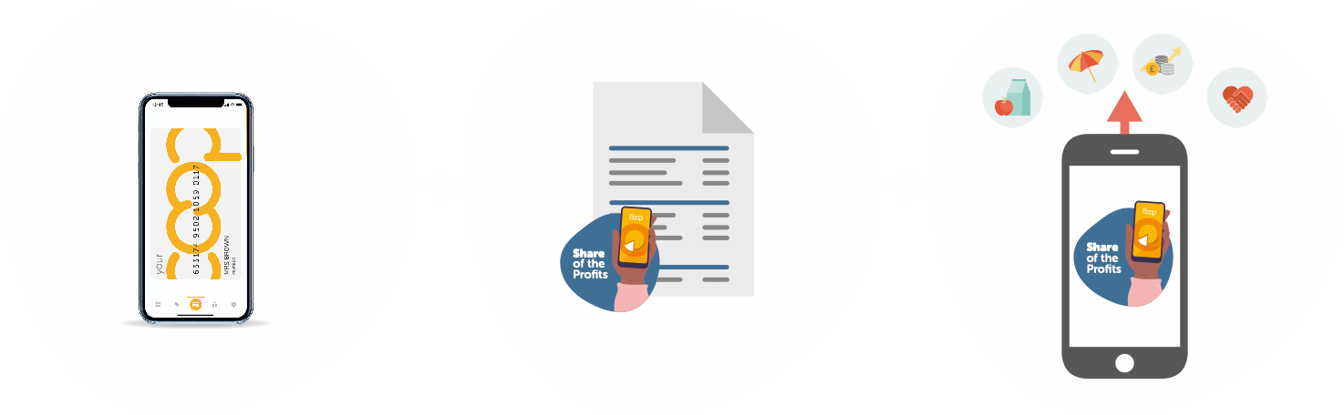
A quick refresh on Share of the Profits
Every time you – and members – shop with us and use your membership card, you earn membership points
Once a year, these points are converted into Share of the Profits.
This time, that share is based on points earned between 24th January 2021 and 22nd January 2022
Members can choose to use their share to spend in any of our trading groups, pay it into their share account, or donate it to charity
3

Slide 4
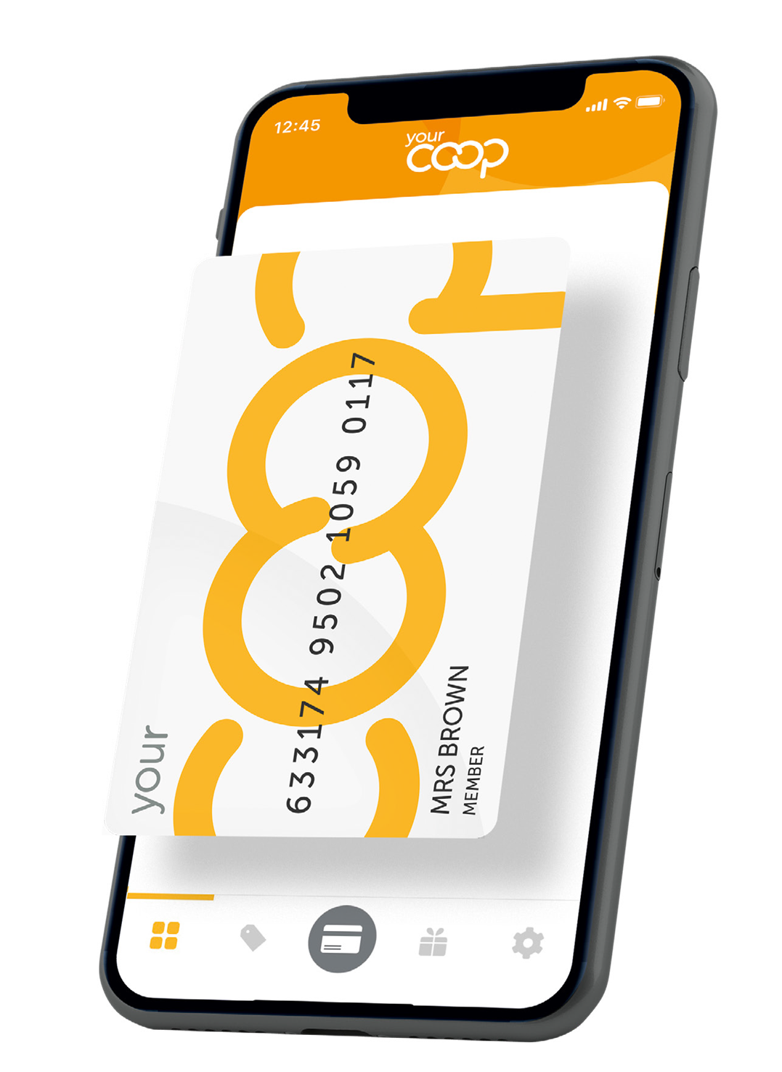


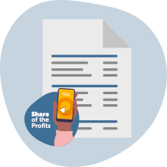

How members will receive their vouchers
Members may receive their vouchers in several different ways
Through the Your Co-op members app – which can be redeemed in Food (if they live by one of our stores), Childcare, Travel and Online Pharmacy
As voucher codes in their letter or email – which can be redeemed in Childcare, Travel and Online Pharmacy
As paper vouchers – which can be redeemed in Food, Childcare and Travel
Directly into their energy, phone, share or bank account or through a donation to charity

Slide 5
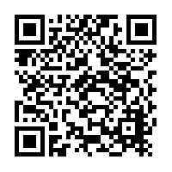
Where to find vouchers on the app
1
Click on ‘Your Co-op’ in the navigation bar
2
Click on ‘Your Vouchers’
3
Click ‘View’ – members will now be able to see their barcodes and voucher codes
5

Slide 6
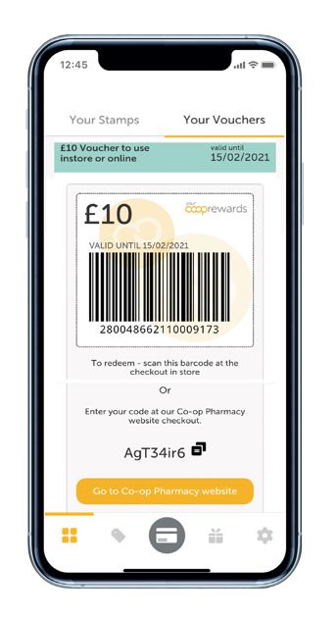
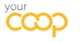
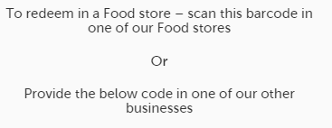
Scanning e-vouchers in Food
Some top tips for scanning e-vouchers and the member’s card:
Use the handheld scanner rather than the 3D fixed scanner where possible
If you use the 3D fixed scanner, ensure it is accessible with no obstructions in the way and that it is clean
If your scanner doesn’t work, ensure you raise an incident via Service Now
6

Slide 7


Scenarios
You can find your voucher codes either on the Your Co-op members app or in the letter or email you received
How do I find my voucher codes?
I need help downloading the app
To download the app, you need to search for ‘Your Co-op membership’ in your app store.
There are other options available, if you refer to your letter or email for further support it contains all the information you need. Or you can check our website
I don’t have a smartphone
Please refer to the FAQs for more detailed scenarios

Slide 8

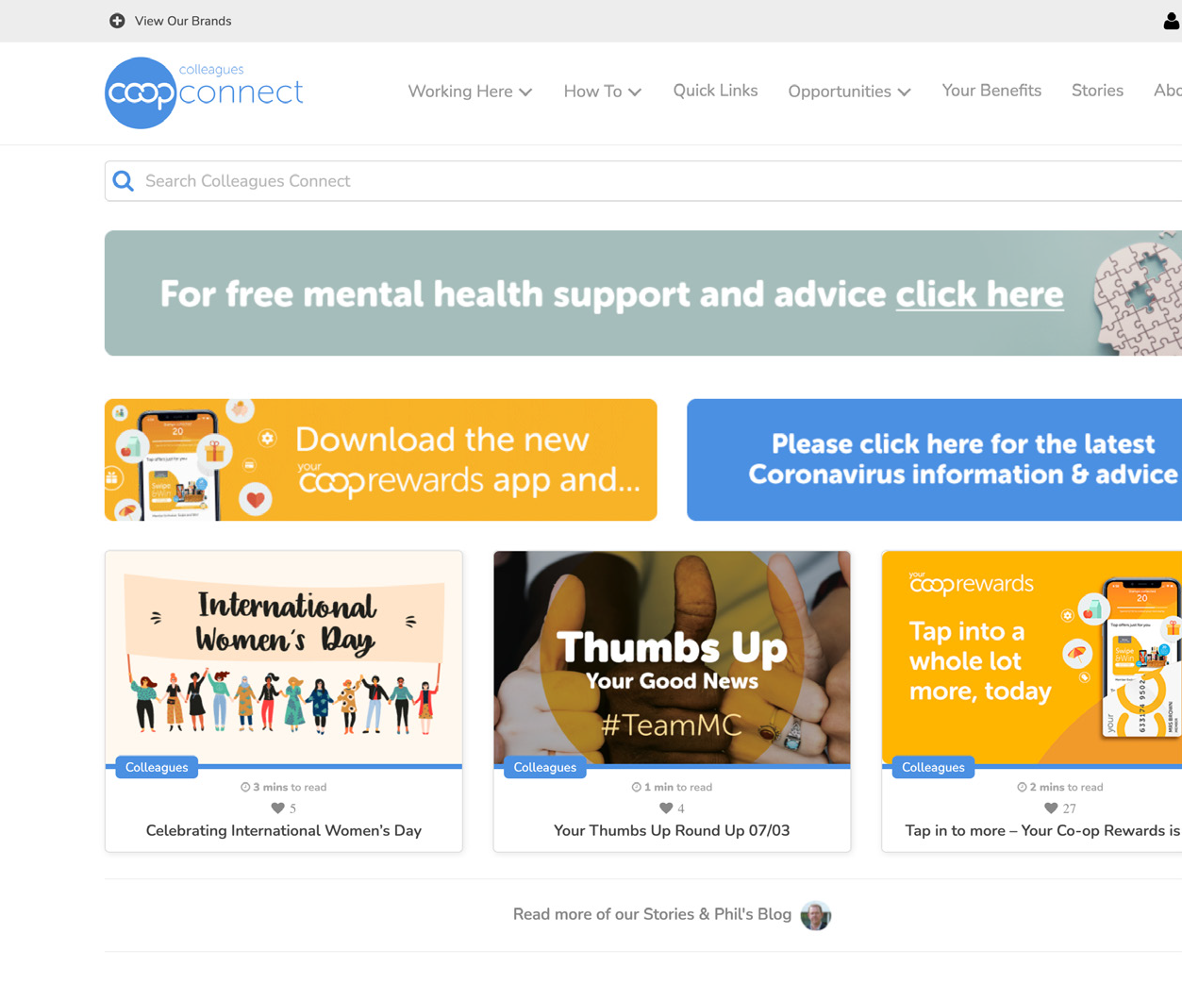

Colleagues Connect:
all your questions answered
A step-by-step guide on how members redeem their e-vouchers in your Group
Frequently asked questions
Guidance on helping members with queries

Slide 9
Thank you

