Slide 1





20190904 Version 1.0

Slide 2
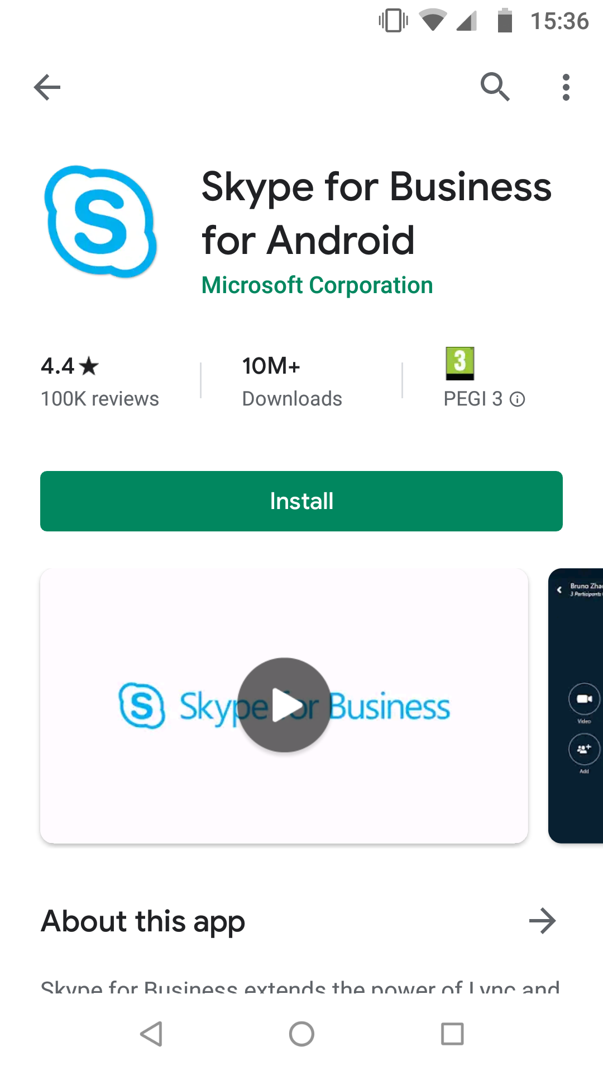


Install Skype for Business App on your Society’s mobile phone
Please see steps below:
Tap on your work profile
Select Play Store
Tap on Skype for Business App
Tap on Install
Once it is installed, tap Open
Tap on the Narrow
Tap Allow if you wish your mobile phone to have access to your photos
Tap Allow to enable Skype for Business to make and manage calls
Tap Allow to enable Skype for Business to record audio
Tap allow to enable Skype for Business to take pictures and record video.
Tap Allow to enable Skype for Business to access your contacts.
Tap Accept on the Terms of Use
Tap on the Narrow
Tap on your work e-mail address
Add your work mobile phone number then click narrow
Scroll through quick start guide then click narrow
You are now logged in and ready to go.
20190904 Version 1.0

Slide 3



Log into Skype for Business App on your Mobile
Please see steps below:
Tap the Skype for Business App icon to open app
Tap on your work e-mail address (for example thomas.test@midcounties.coop) and it is automatically sign in.
Please see useful link below:
Sign in to Skype for Business on mobile device
20190904 Version 1.0

Slide 4
20190904 Version 1.0

