Slide 1
Healthcare Strategy
Executive Colleague Council – 07.04.22

Slide 2
Healthcare - Agenda
Defined Purpose
Agreed Strategy
2022 Activity
Timelines
Questions

Slide 3
Defined Purpose
Purpose:
To enable Members to live healthier & more rewarding lives.
Task
From
Loss making site
Fragmented assortment
Small number of services
Some advice on some things
Individual campaigns
To
£1m contribution within 5 years
Clear range architecture with hero categories
Condition led subscription service to support more positive living
A trusted expert or signpost to the best advice available
Programme of campaign activity on topics that matter most
Strategy
Transform Your Co-op Healthcare into one values driven, trusted provider of healthcare
Increase appeal increase usage increase revenue increase impact
Outcome:
Create an integrated digital service that helps members and customers live healthier and more rewarding lives
3
Notes:
Essentially Digital has moved from add-on to the focal point of the operations

Slide 4
Our Proposed Value Proposition
“Your Coop Healthcare is for people who want to actively manage their health. Unlike other healthcare providers, we offer integrated and personalised care, support and solutions to enable them to live healthier and more rewarding lives ”
Notes:
GA

Slide 5
Proposed Healthcare Strategy House
Strategy
Deliver Integrated & Personalised Care, Support & Solutions
Purpose
To enable members to live healthier and more rewarding lives
Priority Audience
Active Seniors, Busy Professionals & those Starting Out
Supports
Integrated & Personalised Care
We offer tailored assessments and condition management plans based on your health information and needs
Support
We support you on your journey to improved health by ensuring monitoring, professional support and resources are available to you
Solutions
We offer a range of curative and preventative products and services in order for you to achieve your health goals
Experience
Frictionless, Simple, Personalised and helpful
Key Components
Subscription Health Plans
Digital Consultations
Community Healthcare
Campaigns
Online Store
Pharmacy Services
Prescriptions
Health Hub
Desired CTA
Be confident that YCH will improve your health
Tone
Professional, Knowledgeable, Caring
KPI’s
Profitable growth and Member Engagement
Notes:
GA

Slide 6
Key Components Summary – 5 year view
Your Coop Health Plan - Building long term relationships by maximising the use of Technology
Subscription Health Plans
Digital Consultations
Community Healthcare
Condition led subscription proposition for a range of preventative and curative health needs
Digitally enabled - Using member data & for the fulfilment of consultations
Tailored plans that incorporate integrated incentives and discounts from other trading groups
Collaboration with local providers of bespoke services to create all round service
Online Doctor via 3rd party
Bookable Online Pharmacist video consultations
Access to members data to aid consultation process
Access to physical Healthcare services within local communities – i.e. prescription collection points
Collaboration with local providers of bespoke services to create all round service
Work with community partners to provide services to local community
Champion a community give-back scheme
Healthcare Basics- Done Brilliantly
Campaigns
Online Store
Pharmacy Services
Prescriptions
Health Hub
Dedicated campaigning area for causes chosen by our members & working with other co-operatives with an ambition to drive law change
Comprehensive over the counter and P-Med product ranges that are competitively priced
Traditional pharmacy services offered digitally and physically through food stores
Remote prescription delivery operation offering free prescription delivery across UK
Go to place to Members Health questions and queries
Notes:
We want to deliver the basics

Slide 7
Key Components Summary – 2022 Activity
Your Coop Health Plan - Building long term relationships by maximising the use of Technology
Subscription Health Plans
Digital Consultations
Community Healthcare
Launch Health based subscriptions
Create and launch 3 subscription models to test subscription activity, one care related, one condition led and one based around general health services
Implement Pharmacists Consultation Model
Model for digital Pharmacist consultation to be implemented and used as standalone product and as part of subscription and added value component to selected products
Implement 2 physical links to our Communities
Identify 2 ways of physically linking our products and services to our local communities
Healthcare Basics- Done Brilliantly
Campaigns
Online Store
Pharmacy Services
Prescriptions
Health Hub
Champion 2 Campaigns
Champion 2 Health related campaigns (1 existing and 1 new) during 2022
Increase Competitiveness
Full range review across all existing and new categories to establish credibility in market
Increase Brand Exposure
Mobile Vaccination clinics set up within existing trading sites
Increase Patient Numbers
Implement Prescription management and delivery app
Launch “Specialist Subjects”
Identify 5 key categories and launch content Hub

Slide 8
Timelines
Q1
Script App
Online Range
Q3
Subscriptions
Campaigns
Feb
Mar
Apr
May
Jun
Jul
Aug
Sept
Oct
Nov
Dec
Jan
Q2
Digital Consults
Health Hub
Q4
Community HC
Mobile Vaccs

Slide 9
Questions?

Slide 10
Ayesha Di’Angelo

Slide 11
Key Priorities 2022/23
To develop the Young Co-operators Network as a valued resource for its members and increase its participation and engagement
Encourage an understanding of the importance of Democracy in a co-operative and increase democratic Engagement
Promote of the benefits of Membership to the Society and YCN of members under the age of 30.
Raise awareness and promote the importance of community co-operation and create the opportunities for Young Members to get involved in localised Volunteering within Regional Communities.
Raise awareness and promote Co-operative solutions to business and community challenges
Raise awareness to the Society’s wider Sustainability strategy and promote involvement as appropriate

Slide 12
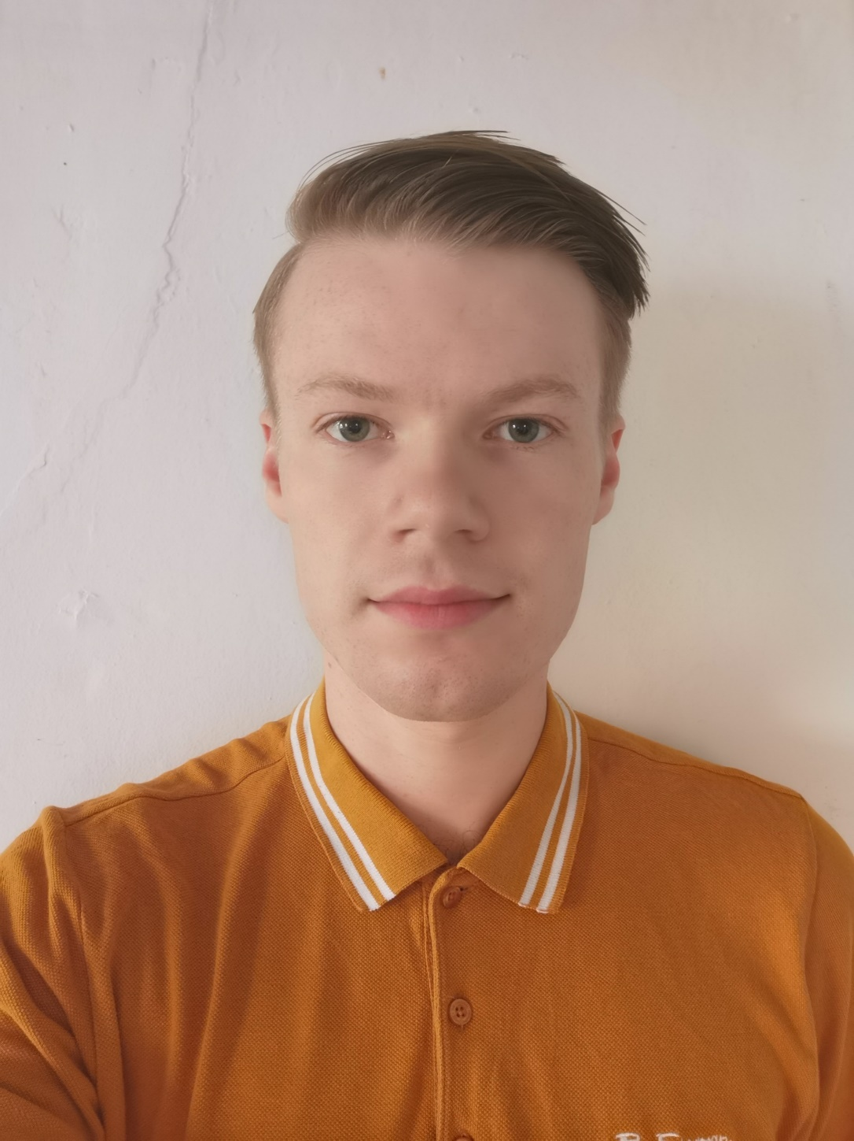
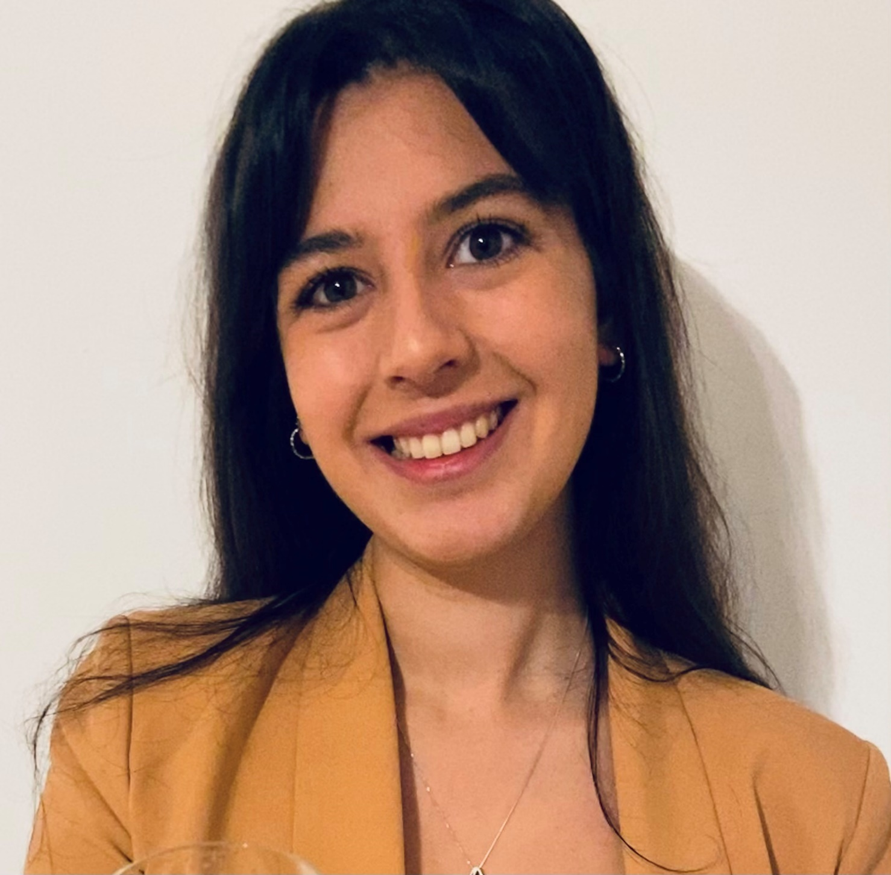
Our MEC Young Members
James McLelland
Young Co-operator
Imogen Head
Insight Analyst
Ben Johnson
Utilities
Emily Stafford
Customer Support

Slide 13
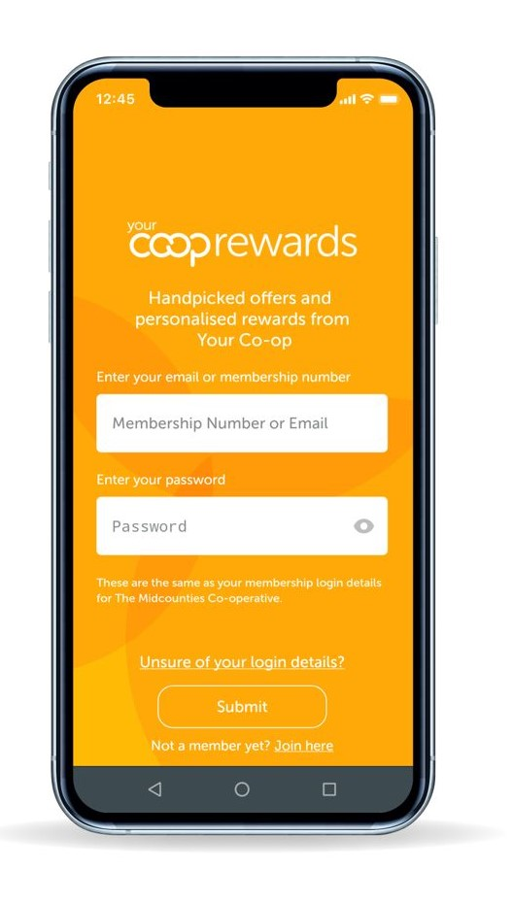
BOOSTING ONLINE engagement
LINKED IN:
Platform for education/ career opportunities
Law firms, Banks are already doing it
Interaction and more Engagement
Link with recruitment/ YCN applicants
INSTAGRAM:
Young people are very active on it
Extra method of engagement
Stories/ Posts
Establishing overall network
Your CO-OP APP:
Make use of the space
Updated posts/ Regular competitions
Platform for surveys/ Interaction
PODCASTS:
Ideal for easy listening back
Gives young people flexibility
Can explore topics that don’t need an audience
‘Submit’ questions option for interaction

Slide 14
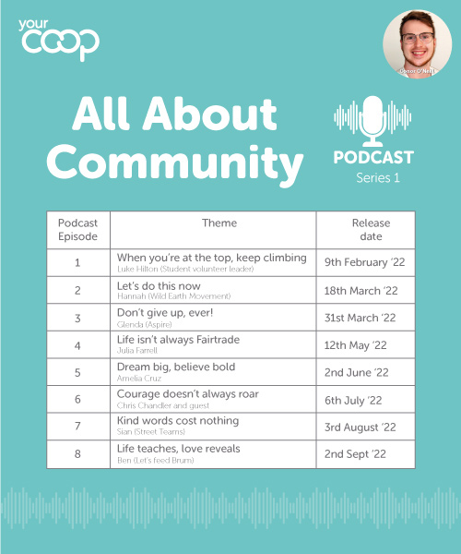
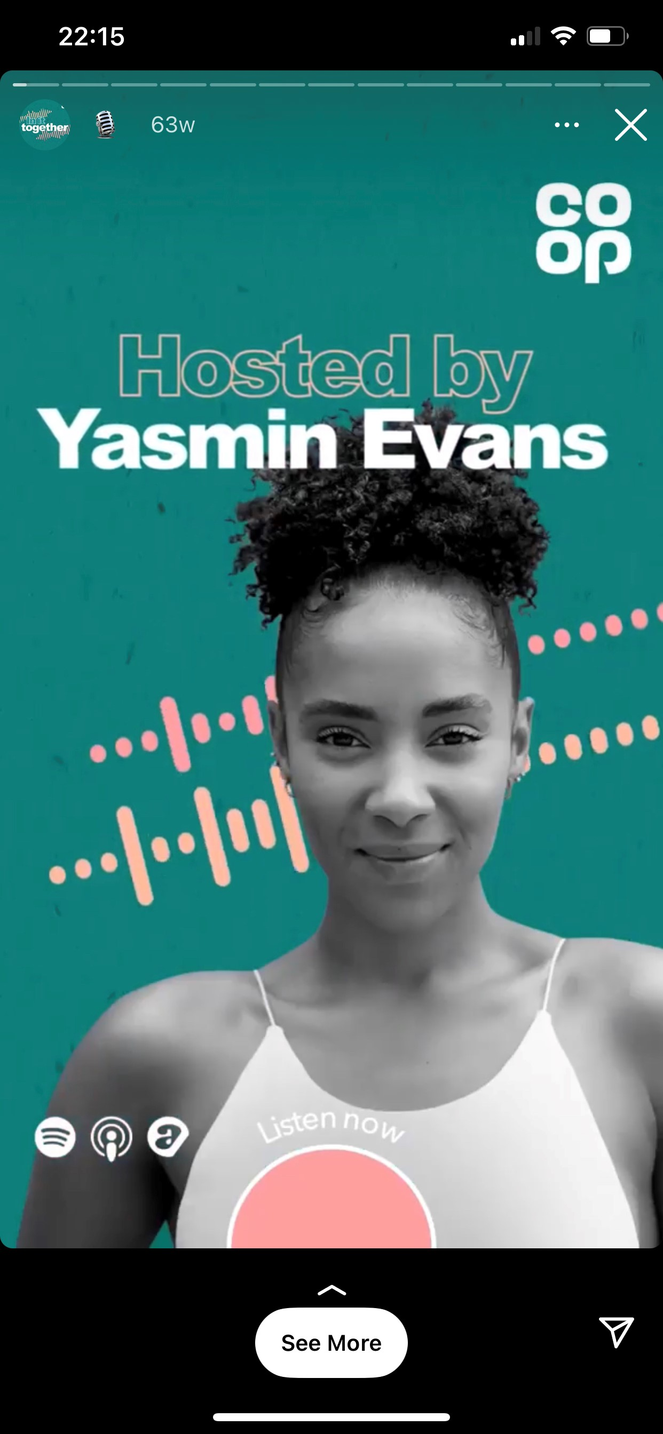
Engagement with Young People – COOP Group UK – In It Together Podcast

Slide 15
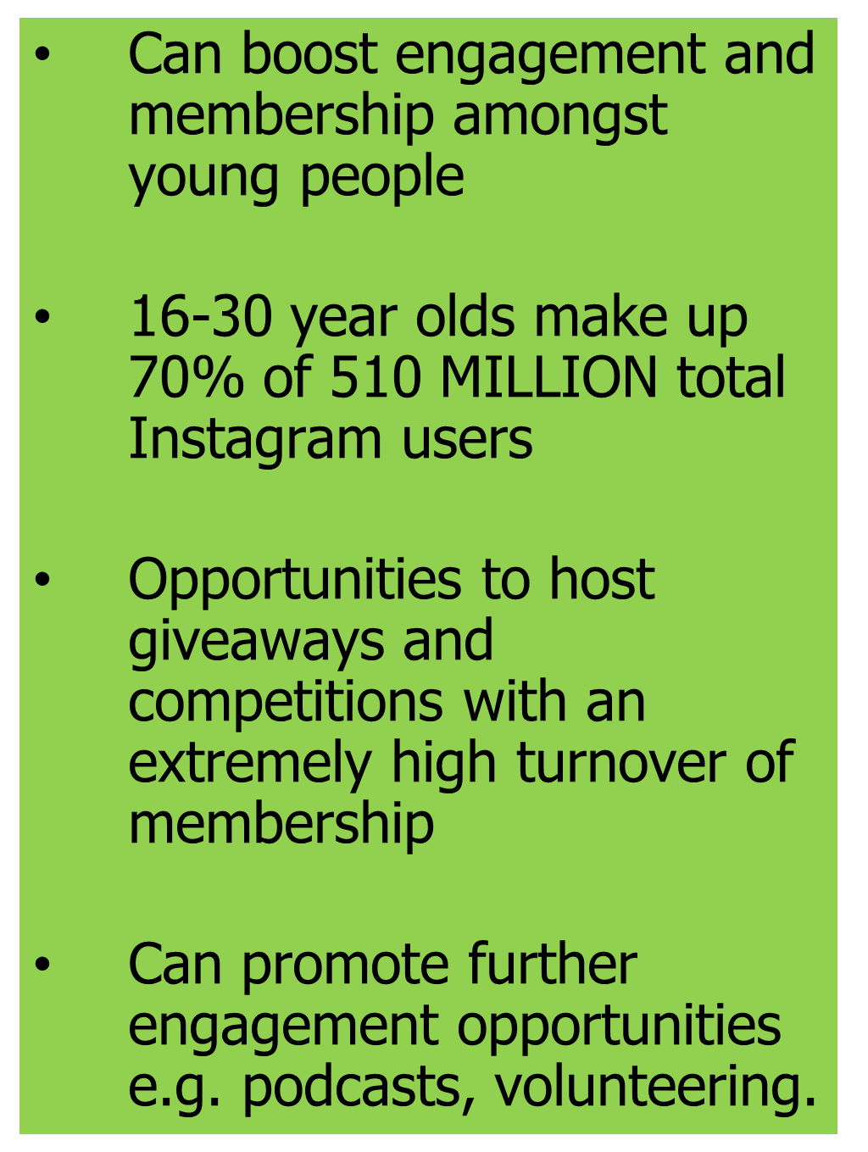
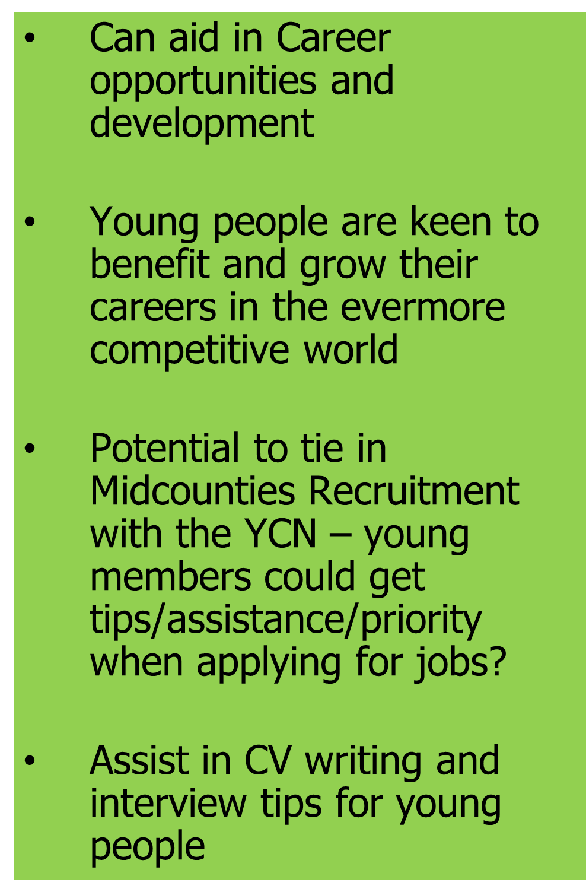
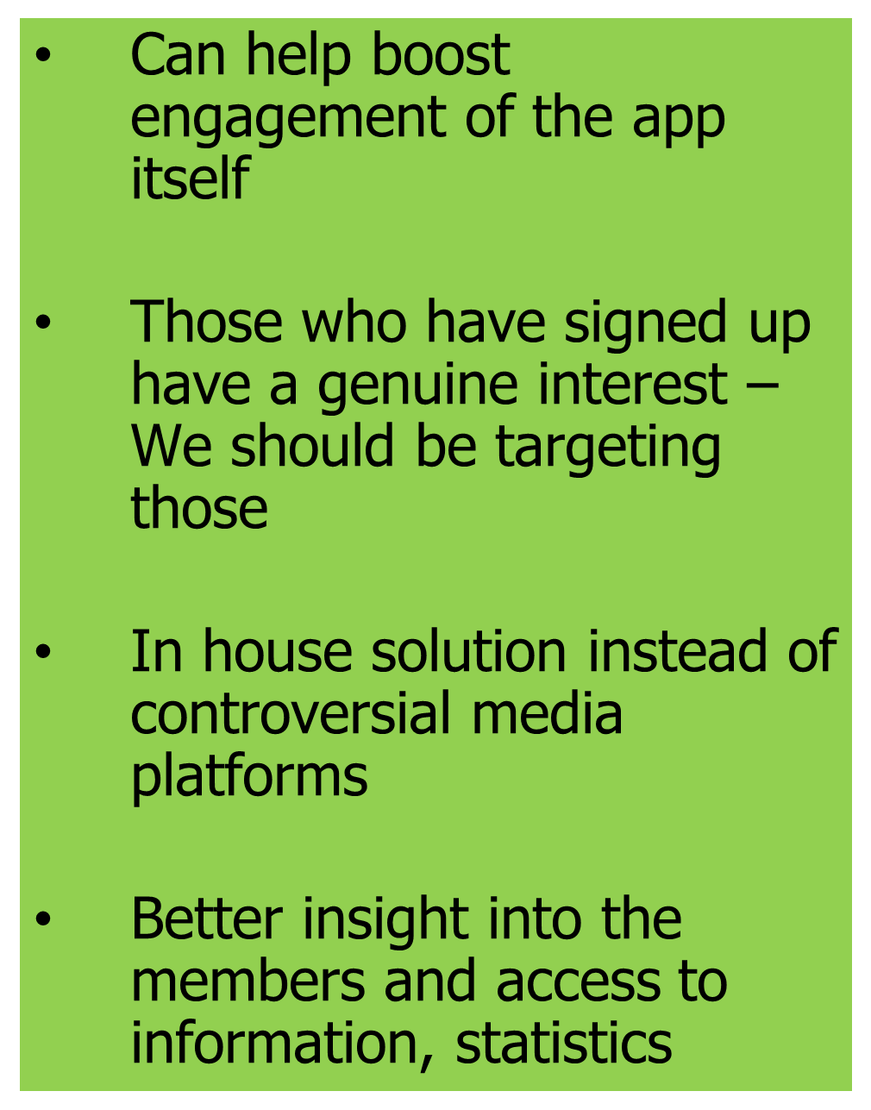

Slide 16
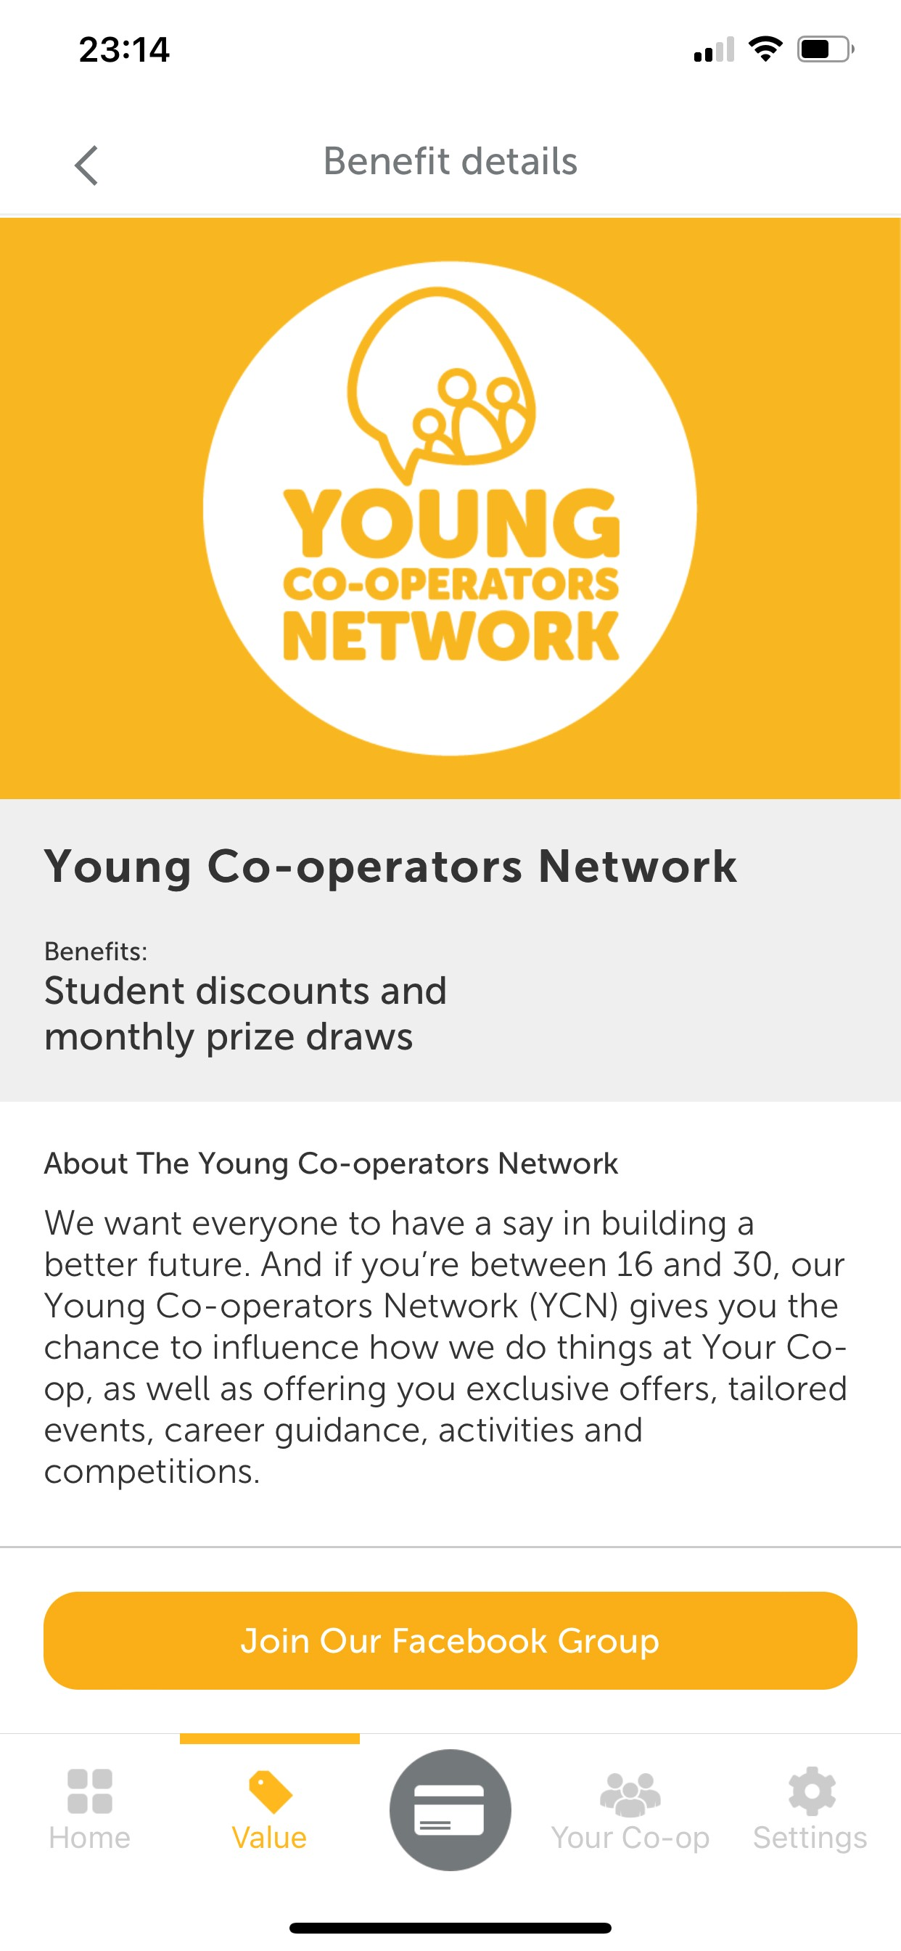
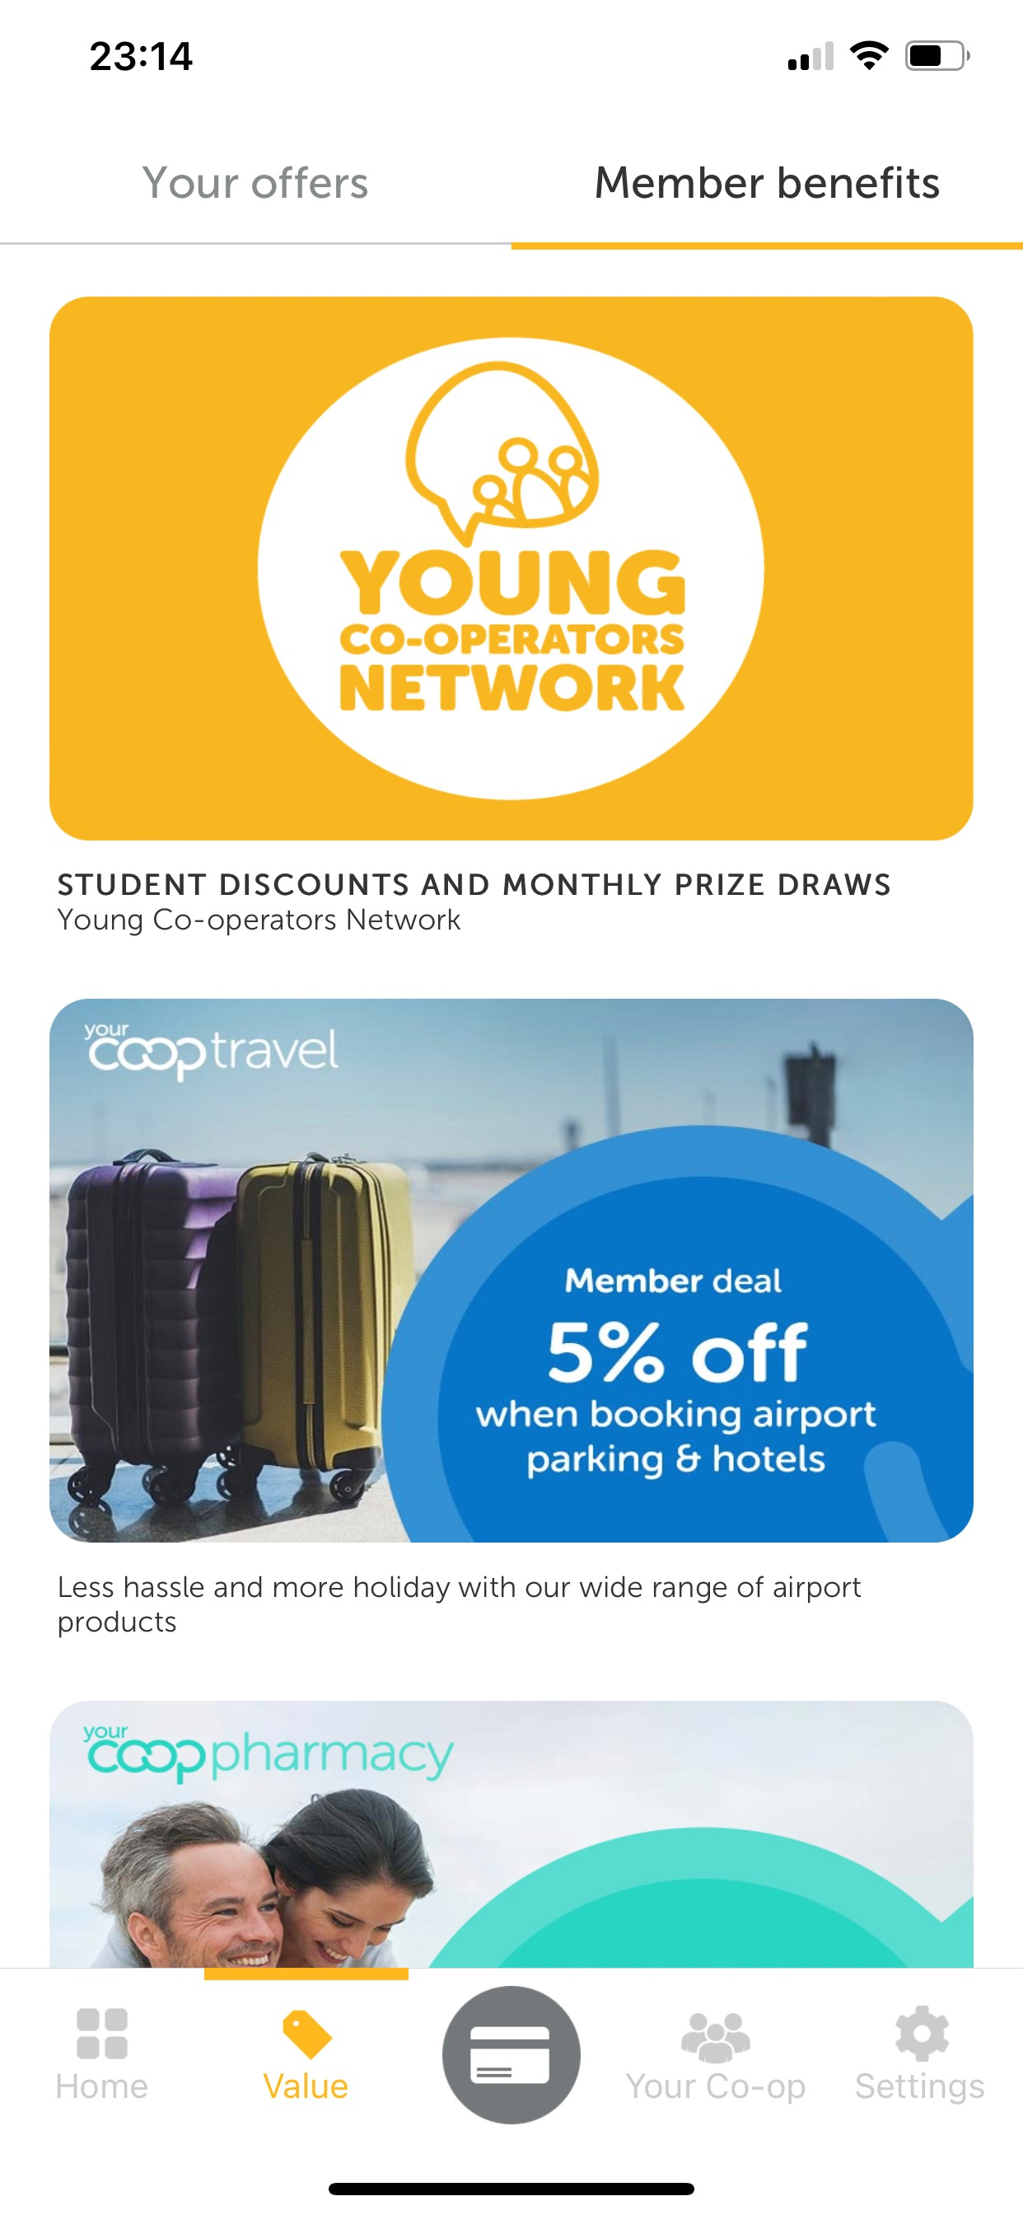
YourCOOP MEMBERSHIP APP

Slide 17
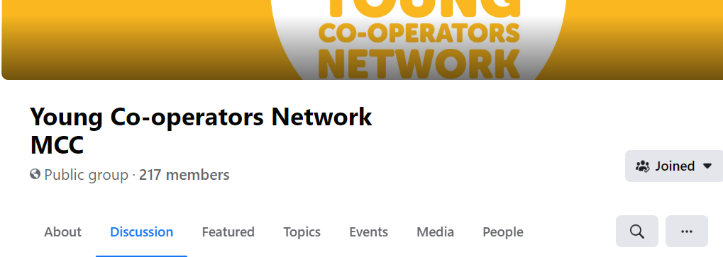
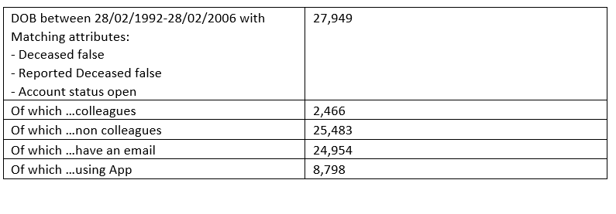
Member App: Measuring our success

Slide 18
What’s going on?
MIND
- Working with Paol to deliver mental health sessions: Life After Covid, Self image
Green Skills Week
Workshop for year 10s alongside Amelia Crews and Fairphone
Global Recycling
Focus into fast fashion brands and impact on our environment. How we can tackle this?
Earth Day
- Raise awareness of the environmental issues which face the whole of planet Earth.

Slide 19
Thank you! Any questions are welcomed!

Slide 20
What Good Looks Like

Slide 21
What is What Good Looks Like?
Driving best performance through engagement
Empowering Store Managers to make decisions
Having great conversations with our teams
Idea sharing and implementation
Effective planning
Reviewing performance regularly
Living by Society values & principles
Store operational standards
Excellent check ins & PDP development
Celebrity in their local community
Reward & recognition

Slide 22
Defining WGLL
SM Workshop
What do they do today?
HR Focus Day
Recap the reason why
WGLL considered for SM & DMs
Senior Leaders Workshop
Recap reason why
DM Workshop
What are the focus areas?
What does good look like?
Types of managers
WGLL communication for leaders
Leader roles considered for 4 key areas
DM workshop approach
Commitments
Recap reason why
Align WGLL with the 4 key areas
Types of managers

Slide 23
LEAD Framework
Experience
Ensure the best possible experience for our customers and members by bringing to life the full range of products & services
Lead & Inspire
To lead and inspire teams to be the best they can be as a team or individually
L
E
D
A
Demonstrate Co-Operation
Managers to be visible, active & collaborative in their communities. Acting at a Society, Regional, Community & Site level
Achieve
Achieve targets to deliver profitable stores which are safe, legal, compliant & clean

Slide 24
Store Manager Behaviours
Leader
Multi-tasker
Engaging
Target driven
Customer orientated
Resilient
Succession planning
Safe environment
Professional
Drive best performance
Coaching and mentoring
Bringing out the best in the team
Right place, right time
Colleague development
People leader
What words could be used to describe a good Store Manager?
What does the business rely on the Store Manager role for?

Slide 25
Indicators of Lead & Inspire
Have a genuine interest in their team, know & understand them whilst developing and supporting their wellbeing
Create a fun, engaging, diverse & inclusive team environment that allows our colleagues to flourish, & love to work
Have a feedback culture & be confident to have open & honest conversations with positive re-enforcement
Have a performance culture where great performance is celebrated & under performance in managed for improvement

Slide 26
Indicators of Customer & Member Experience
Understanding of what a member focussed store experience looks like, and coaching the team to provide outstanding customer service
Role model excellent customer service to the colleague
Build a team that have customer service excellence, and think Customer first and are knowledgeable of Midcounties products and services

Slide 27
Indicators of Achieve Profitable Stores
Deliver stores KPI’s by having a action plan for areas of improvement
Maximise the value of membership and lifetime value of a member
Best in class leader in legalities, cleanliness and operational standards

Slide 28
Indicators of Demonstrate Co-operation
Be a celebrity in the local community
Be a role model & champion for colleagues and members to get involved
Embrace and have a positive impact on sustainability for the Society and in local community

Slide 29
District Manager Changes
Changes to visit schedule in frequency and length
More time for you
Coaching sessions
Creating a safe environment
Being a catalyst for great conversations
Open door sessions
Talent pooling
Reward and recognition
L
E
D
A

Slide 30
DM Indicators of Lead & Inspire
Create and own a District succession plan, that allows colleagues to reach full potential
Enable and embed change through coaching and leading SM through effective communication
Have a performance culture where great performance is celebrated and under performance is managed for improvement

Slide 31
DM Indicators of Customer & Member Experience
Analyse customer insight and data to coach teams to deliver best customer service
Celebrate success and coach for improvement when service is not to required standard
Work with Central support teams to understand the customer trends and store demographics to influence the range and services whilst driving passion for food
Coach store teams to drive membership to achieve society aspirations for membership

Slide 32
DM Indicators of Achieve Profitable Stores
Working with SM’s to help them to achieve their KPI’s, track and measure store and individual performance
Delivery of consistent what good looks like by inspiring store teams to be best in class
Create a network to identify key trends in social / economic impacts and competition analysis

Slide 33
DM Indicators of Demonstrate Co-operation
Hold a community ambassador role, promote MCC values and the cooperative difference across our trading area
Be a role model demonstrating knowledge and passion of society values and principles
Create an environment to champion best in class and share best practice

Slide 34
Questions?

Slide 35
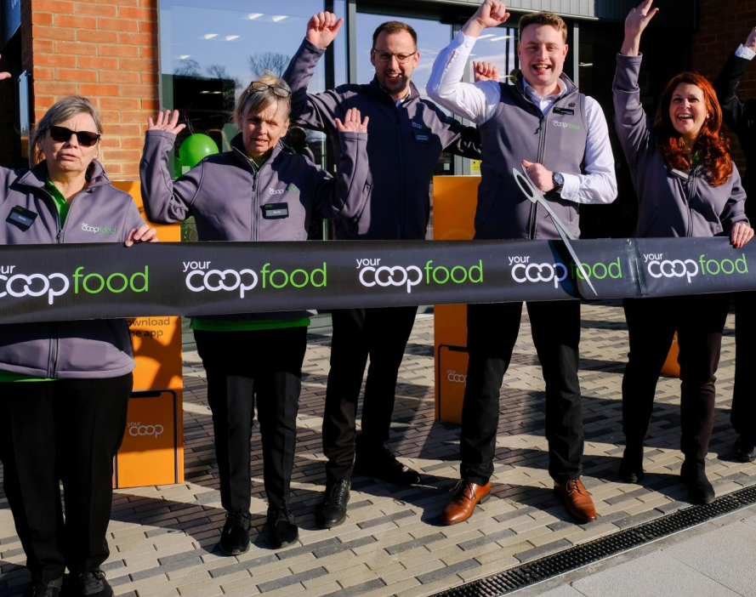
Executive colleague council 7 April 2022

Slide 36
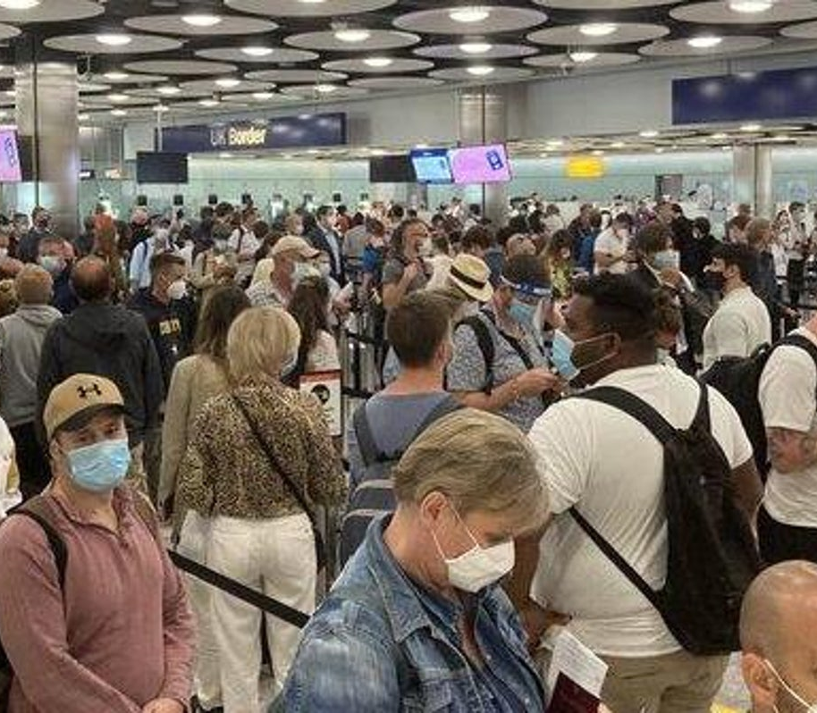
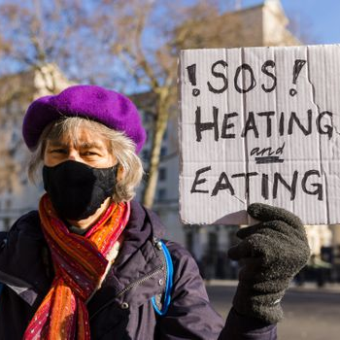

Slide 37
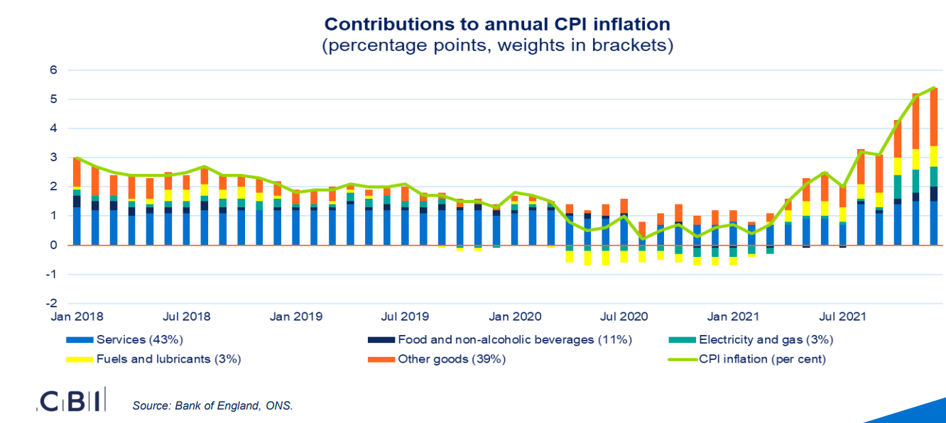

Slide 38
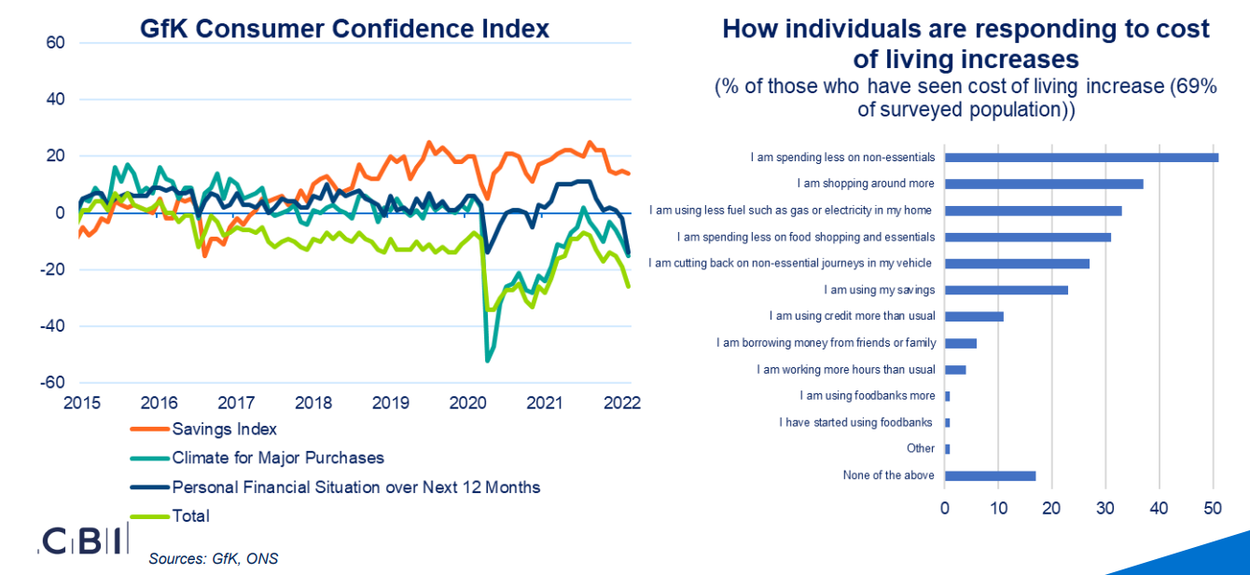
Consumer impacts

Slide 39
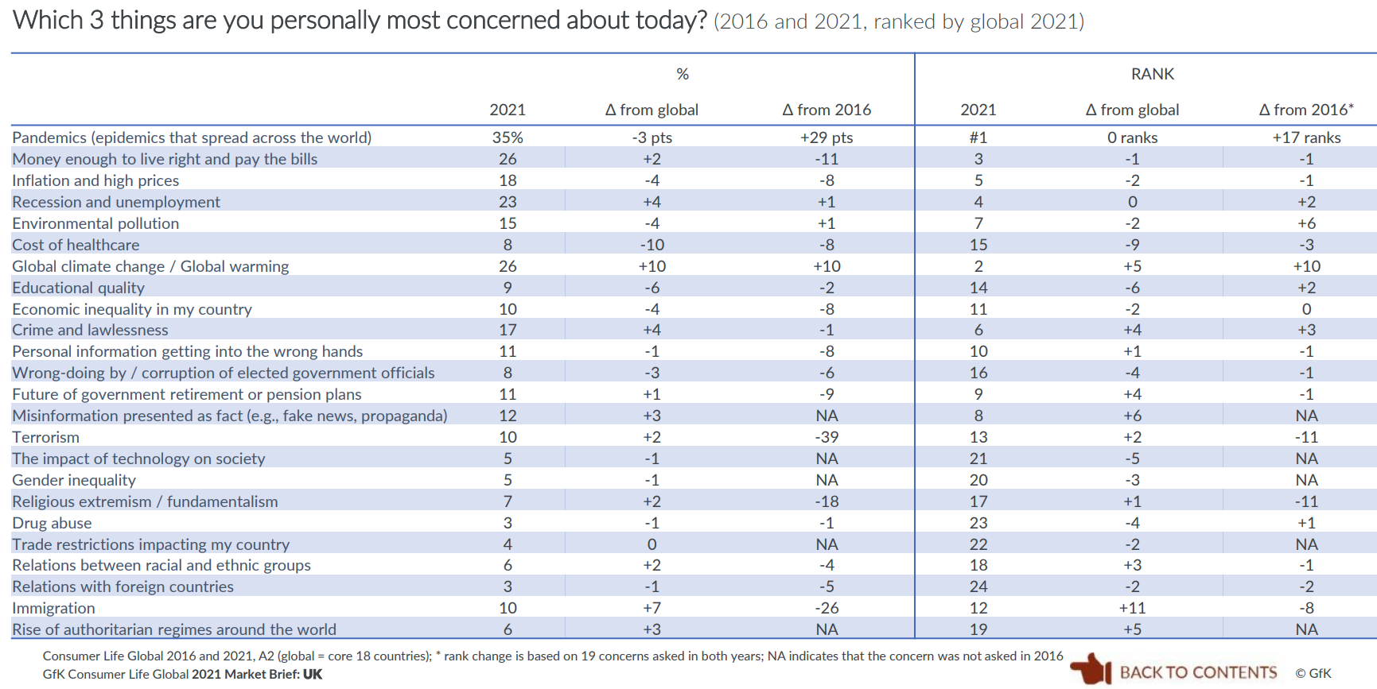

Slide 40
GB market shares: March 2022
The GB market* declined 6.3% in the 12 weeks to 20 March against 2021’s elevated performance, according to the latest results from Kantar.
Compared to March 2020 when the pandemic impact started, sales are ahead by just 0.7%.
Grocery inflation reached 5.2% in March, a step up on February’s 4.3%. It is now at its highest level since April 2012.
Other
multiples
Symbols
& independents
Market growth -6.3%
Source: Kantar Worldpanel, 12 weeks to 20 March 2022, IGD Research * Take home grocery sales

Slide 41
2022 vs 2020: providing a two-year comparison
To give further context to the year-on-year sales growth, this graph shows 2022’s results vs 2020, showing a comparison against sales recorded at the start of the pandemic.
Market growth +0.7%
Source: Kantar Worldpanel, 12 weeks to 20 March 2022, IGD Research

Slide 42
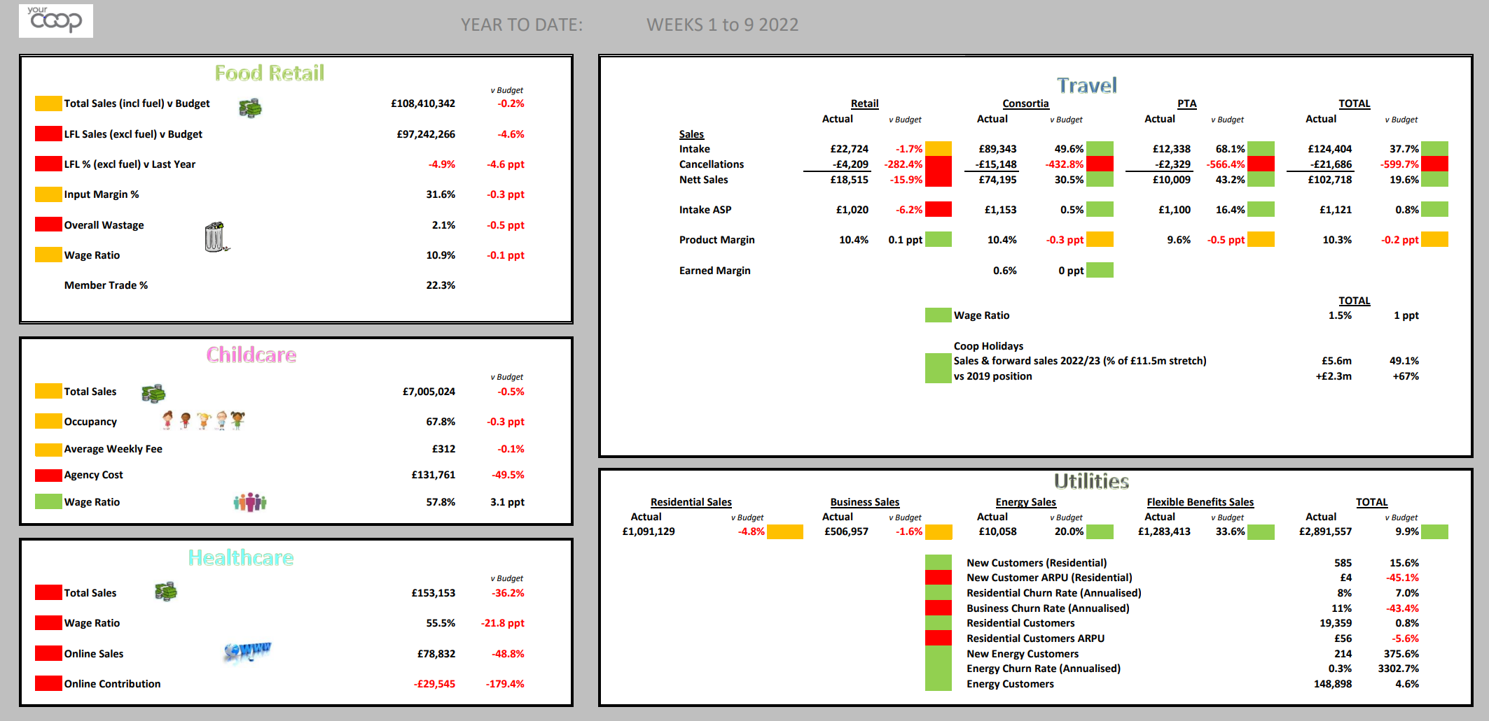
Two periods in

Slide 43
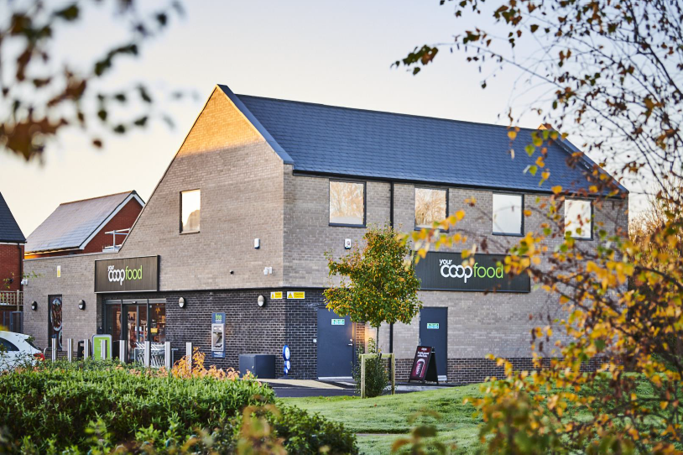
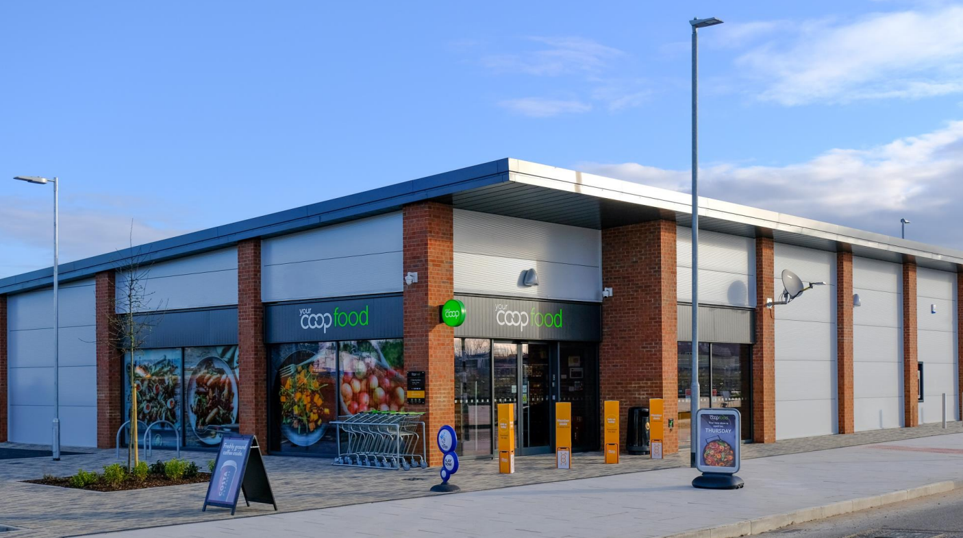
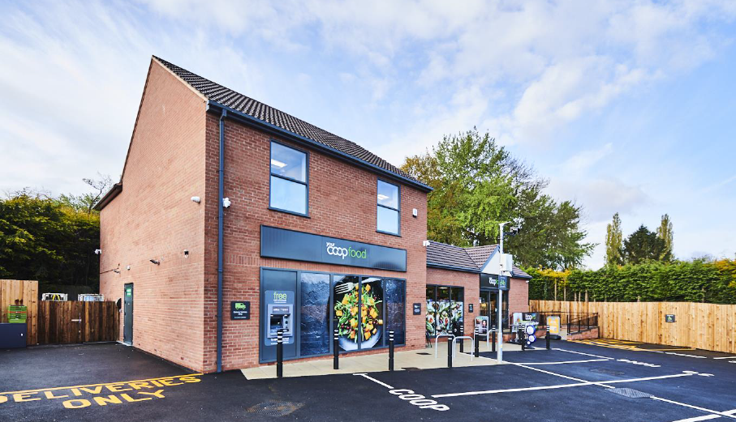
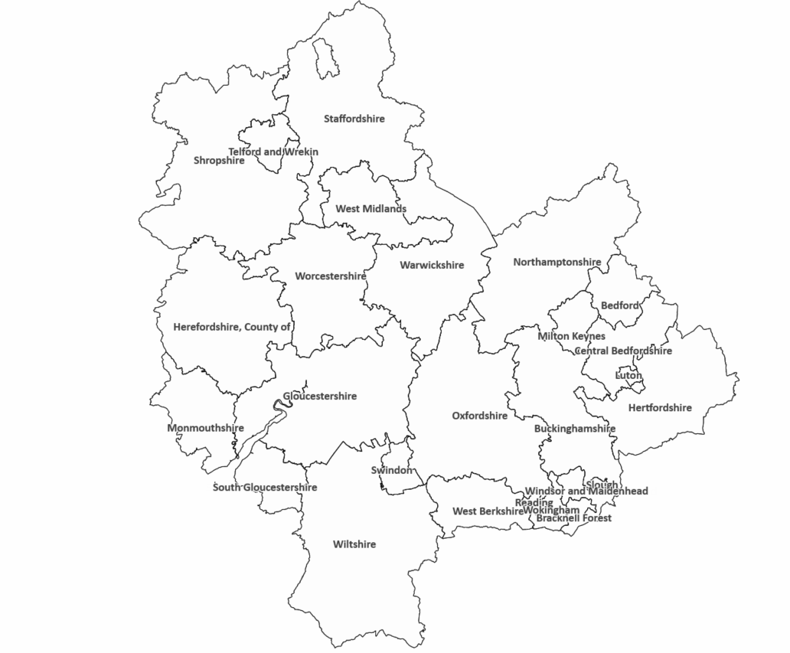
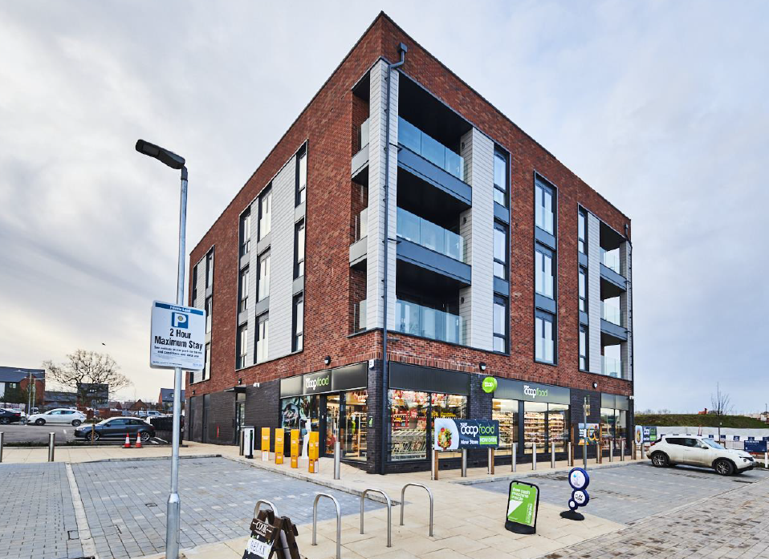
Convenience store
Requirements
Geography
Target growth areas includes below counties:
Shropshire, Staffordshire, West Midlands, Herefordshire, Worcestershire, Warwickshire, Northamptonshire, Monmouthshire, Gloucestershire, South Gloucestershire, Oxfordshire, Buckinghamshire, Bedfordshire, Hertfordshire, Wiltshire, Berkshire
Location
Central to strong residential catchment
Major transient routes
Local Centre opportunities
Strong access/egress
Excellent visibility
Sites
0.4-0.5 acres
Units of up to 4,500 sq. ft gross
Minimum of 15 parking spaces
Existing Buildings
Retail units
Mixed use developments
Pub conversions
Tenure
Freehold/Leasehold
Trading/Growth Areas

Slide 44
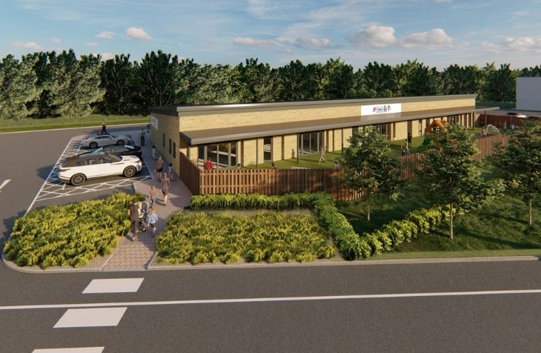
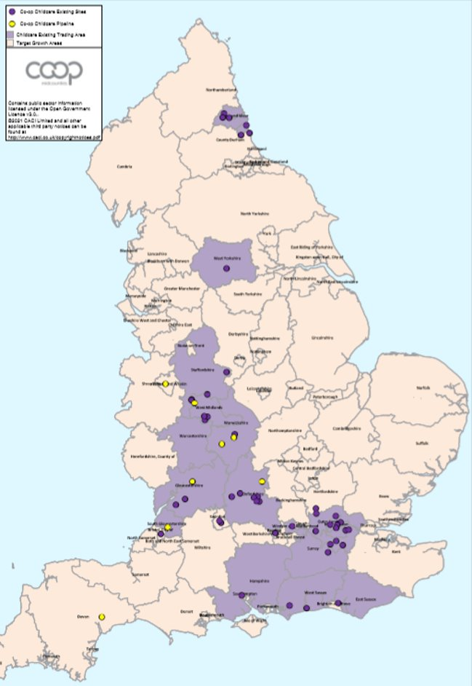
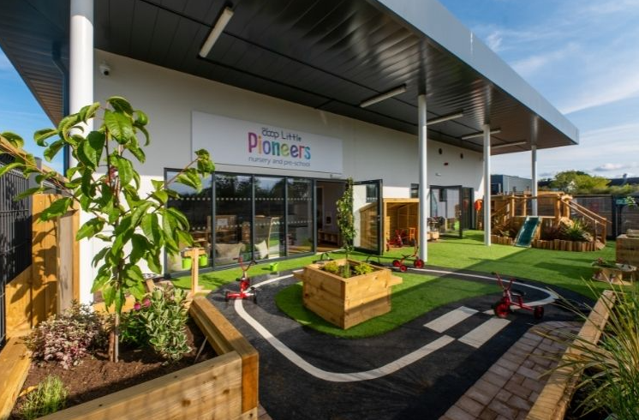
Childcare nursery Requirements
Existing locations
Geography
Nationwide across England
Location
Strong residential catchment and proximity to areas of significant employment such as Hospitals/Universities as well as major transport/infrastructure links.
Sites
0.5-0.6 acres
Existing Buildings
Ideally single storey
5,000 to 6,000 sq. ft. plus 3,500 sq. ft outdoor space
20 parking/drop-off spaces
Strong accessibility and visibility
Planning
Class E – no requirement for change of use from shops, offices, pubs, restaurants etc.
Tenure
Freehold/Leasehold considered.

Slide 46
Member engagement
Over 60,000new app users

