Slide 1

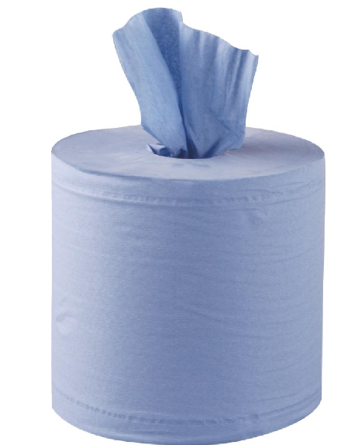


TAP CLEANING/DISINFECTION ChemEco Bio Surface Sanitiser
s
1
2
READ BEFORE
STARTING
Fill spray bottle to 600ml and add 1 pump of Bio Surface Sanitiser.
Spray diluted product onto cleaning roll.
3
4
Wash / wipe all surfaces to remove debris.
Allow 30 second contact time to ensure germ kill.
Always wear correct PPE
Gloves
5
6
Spray diluted product onto a new cleaning roll.
Wash / wipe items or surfaces to remove debris.
Use your cleaning tools
7
8
Allow 30 second contact time to ensure germ kill.
Rinse with clean water.

Slide 2

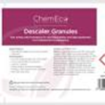
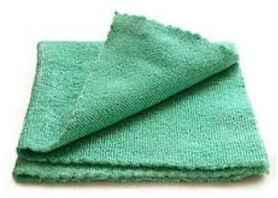
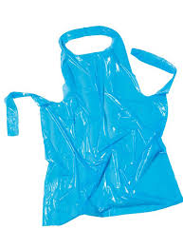
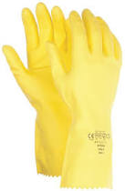
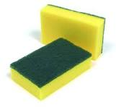


TAP DESCALING ChemEco Descaling Granules
1
2
READ BEFORE
STARTING
Collect your PPE, equipment and ChemEco descaler granules
Using a damp scourer apply granules to all surfaces where limescale has built up and work over
3
4
Always wear correct PPE
Leave to work for 5 minutes.
Repeat point 2 until visibly clean and free from limescale.
Gloves, Apron, Goggles
5
Rinse with clean water and dry with blue roll
Use your cleaning tools
Products:
Descaler granules

